Slide 1




Advance Analog and Mixed Signal Design
Lecture 1
Oscillator Fundamental
Dr. Neeraj Mishra
High Performance Electronics Lab
Electrical & Electronics Eng. Dept.
Birla Institute of Technology & Science Pilani, Pilani Campus

Slide 2
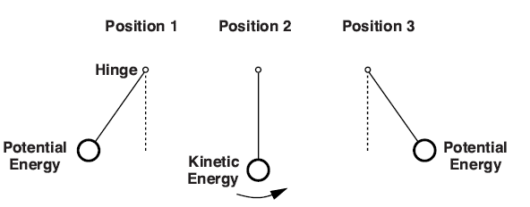
Oscillator Essentials for PLL
The oscillator is the heartbeat of every PLL, and
Its principles provide the backbone for understanding complex timing and frequency control systems.
The pendulum analogy introduces the idea of oscillation as a cycle of energy conversion—potential to kinetic and back—highlighting the natural tendency of oscillatory systems to maintain regular, predictable cycles unless disrupted by losses (e.g., friction, air resistance).

Slide 3
Oscillator Essentials
Oscillation arises from energy balance and feedback: Initial energy (displacement or charge) starts oscillation; kinetic and potential forms alternate.
Real systems lose energy due to imperfections—without feedback, oscillation fades. In PLLs, electronic “feedback” circuits sustain oscillation and control frequency.
Critical takeaway: The period (frequency) of oscillation is set by system properties (e.g., in electronics, by inductance and capacitance, in mechanics by pendulum length). This fundamental independence from amplitude forms the foundation for stable timing in PLLs.
In “lossless” systems, introducing energy at just the right frequency makes oscillations grow without bound, showcasing resonant amplification—a key concept in both analog oscillators and PLL loop dynamics.

Slide 4
Pendulum and Electronic Oscillators for PLLs
A pendulum swings back and forth by continuously converting between potential energy (highest at the endpoints) and kinetic energy (highest at the center).
This cycle of energy transfer is called simple harmonic motion.
In electronics, an LC circuit (inductor-capacitor) also shuttles energy, but between magnetic energy (inductor) and electric energy (capacitor) as current and voltage oscillate.
Mathematically, both systems are governed by similar second-order differential equations. So, understanding a pendulum's movements helps students grasp energy exchange in oscillators.
A pendulum acting as an oscillatory system.

Slide 5
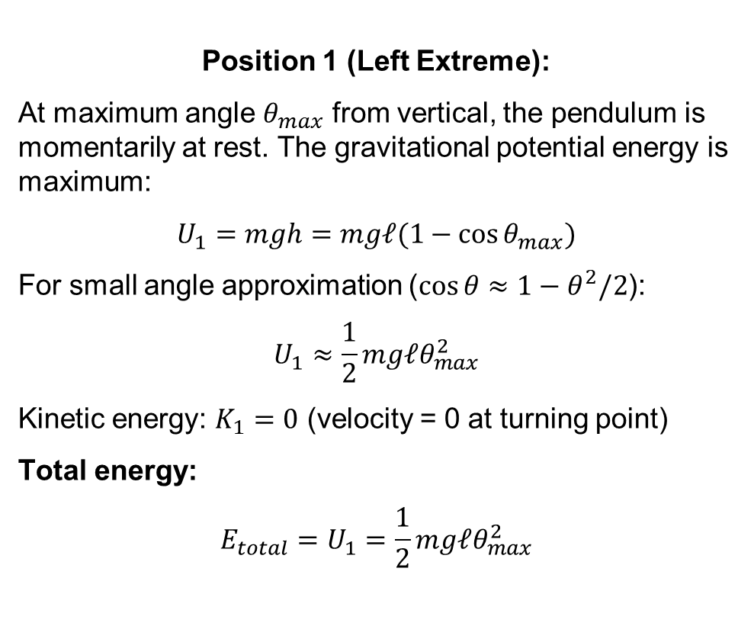
Physical Setup and Energy
Position 1 (Left Extreme):
At maximum angle $θ_{max}$ from vertical, the pendulum is momentarily at rest. The gravitational potential energy is maximum:
$$U_{1}=mgh=mg𝓁(1−cos⁡θ_{max})$$
For small angle approximation ($cos⁡θ≈1−θ^{2}/2$):
$$U_{1}≈\frac{1}{2}mg𝓁θ_{max}^{2}$$
Kinetic energy: $K_{1}=0$ (velocity = 0 at turning point)
Total energy:
$$E_{total}=U_{1}=\frac{1}{2}mg𝓁θ_{max}^{2}$$
Framework

Slide 6
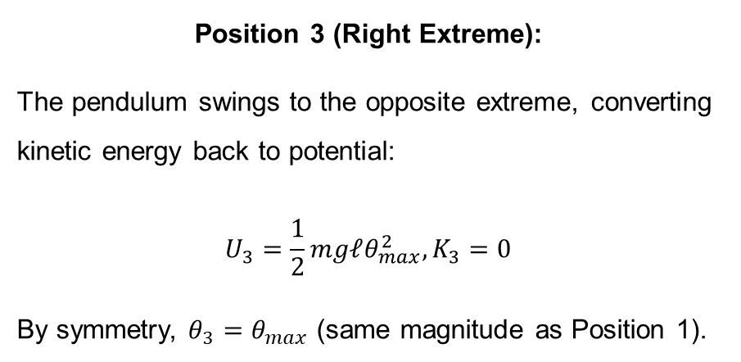
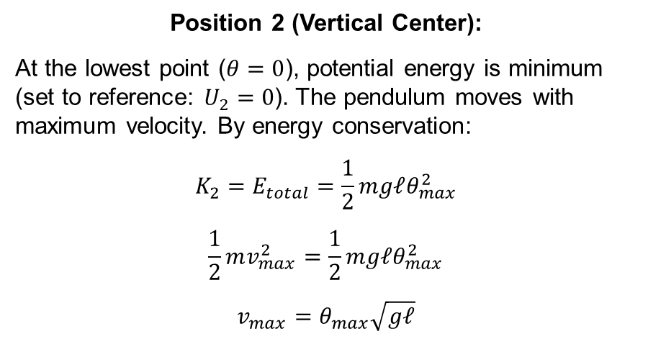
Position 2 (Vertical Center):
At the lowest point ($θ=0$), potential energy is minimum (set to reference: $U_{2}=0$). The pendulum moves with maximum velocity. By energy conservation:
$$K_{2}=E_{total}=\frac{1}{2}mg𝓁θ_{max}^{2}$$
$$\frac{1}{2}mv_{max}^{2}=\frac{1}{2}mg𝓁θ_{max}^{2}$$
$$v_{max}=θ_{max}\sqrt{g𝓁}$$
Position 3 (Right Extreme):
The pendulum swings to the opposite extreme, converting kinetic energy back to potential:
$$U_{3}=\frac{1}{2}mg𝓁θ_{max}^{2}, K_{3}=0$$
By symmetry, $θ_{3}=θ_{max}$ (same magnitude as Position 1).

Slide 7
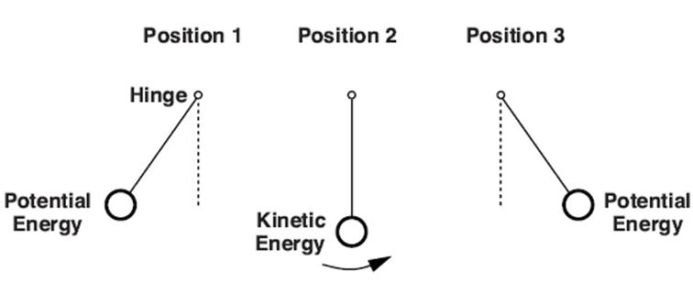
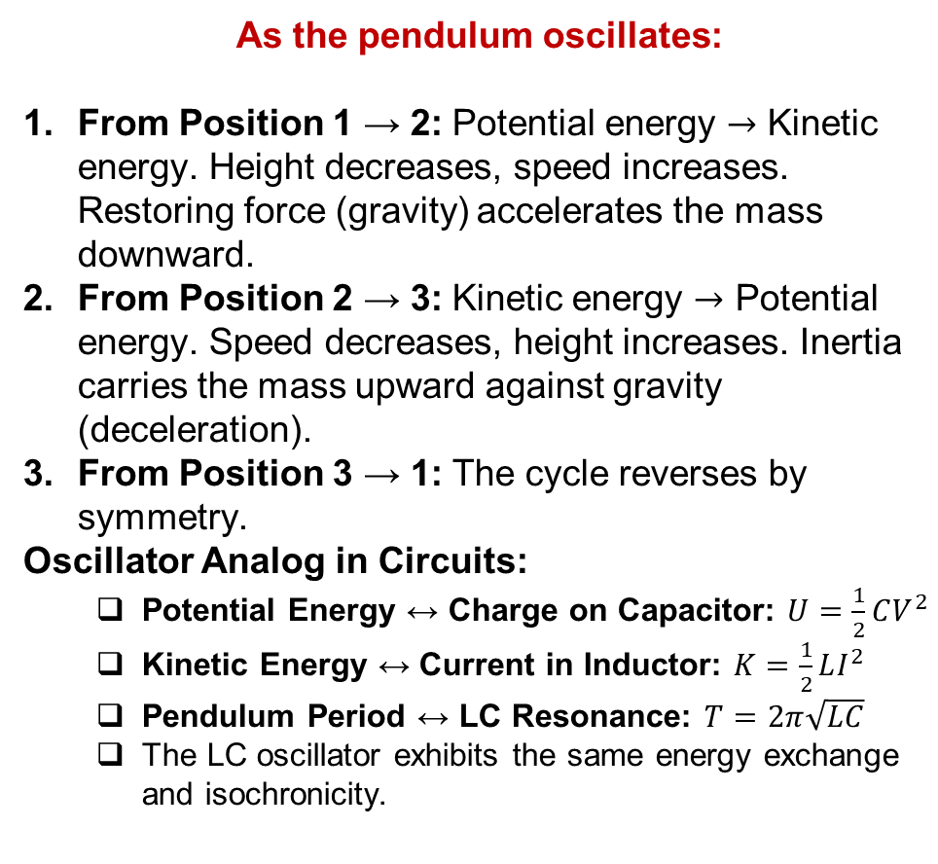
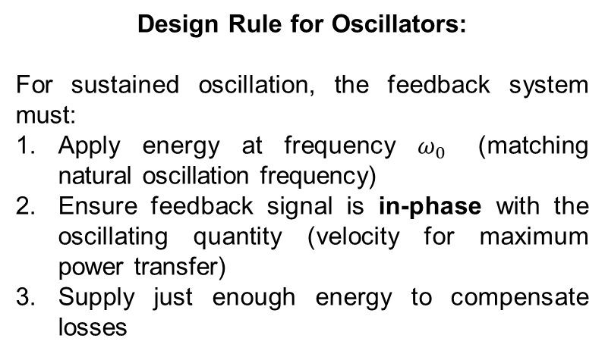
As the pendulum oscillates:
From Position 1 → 2: Potential energy $→$ Kinetic energy. Height decreases, speed increases. Restoring force (gravity) accelerates the mass downward.
From Position 2 → 3: Kinetic energy $→$ Potential energy. Speed decreases, height increases. Inertia carries the mass upward against gravity (deceleration).
From Position 3 → 1: The cycle reverses by symmetry.
Oscillator Analog in Circuits:
  Potential Energy ↔ Charge on Capacitor: $U=\frac{1}{2}CV^{2}$
  Kinetic Energy ↔ Current in Inductor: $K=\frac{1}{2}LI^{2}$
  Pendulum Period ↔ LC Resonance: $T=2π\sqrt{LC}$
  The LC oscillator exhibits the same energy exchange and isochronicity.
Design Rule for Oscillators:
For sustained oscillation, the feedback system must:
Apply energy at frequency $ω_{0}$ (matching natural oscillation frequency)
Ensure feedback signal is in-phase with the oscillating quantity (velocity for maximum power transfer)
Supply just enough energy to compensate losses

Slide 8
2. How Feedback Sustains Oscillation
Both mechanical and electrical oscillators lose energy over time due to friction, air resistance, or circuit resistance.
In a pendulum, you can keep it swinging by periodically “pushing” it at the right times—this adds energy to counteract losses.
In electronic circuits, feedback and amplification play the same role: an amplifier can sense the decreasing oscillations and boost them to keep the cycle going.
In a PLL, this active feedback is critical for maintaining stable oscillations and compensating for loss, like a steady hand keeping the pendulum swinging.
Quick Check:
Can you imagine what would happen to a pendulum or LC oscillator if you stopped adding energy through feedback or “pushes”?

Slide 9
3. Connecting Mechanical Examples with Electronic Counterparts
Pendulum: Shows conservation of energy, natural frequency depends only on length (not mass), amplitude-independent period for small swings.
LC Oscillator: Energy flips between capacitor and inductor, natural frequency depends only on L and C values — not amplitude, just like pendulum.
Ring oscillator: Instead of energy storage elements, uses delay and gain in logic inverters to create periodic transitions.
Link to PLLs: PLLs use voltage-controlled oscillators (VCOs) where feedback adjusts the energy input to maintain a target frequency, effectively “steering” the oscillator based on phase comparisons—much like nudging the pendulum to match a clock’s beat.

Slide 10
4. Frequency Selectivity and Feedback: The Heart of Oscillators and PLLs
Oscillators and PLLs select and stabilize frequencies not by amplitude or energy, but by intrinsic system properties (length for pendulum, LC values for circuits).
In PLLs, feedback is used not only to sustain oscillations but also to lock the output to a desired phase/frequency, reducing “jitter” and improving signal quality.
Takeaway:
  Energy cycling: All oscillators rely on a back-and-forth energy conversion.
  Feedback is key: Periodic “pushes” or feedback are what make oscillators persistent.
  Frequency comes from physical parameters, not how “hard” you push.
  PLLs harness these features to keep signals steady and accurate—for timing, synchronization, and high-performance circuit design

Slide 11
Mechanical Analogy & Oscillatory Feedback
Pendulum to Feedback System: As in a pendulum, where energy cycles between kinetic and potential forms, electronic feedback circuits shuttle signals around a loop. Figure 1.2(a) shows a simple feedback system: at every moment, the feedback (the loop) can either stabilize (reduce amplitude) or destabilize (grow amplitude), depending on the phase and gain.
Amplifier Example: Figure 1.2(b) uses an op-amp to realize feedback. At low frequencies, it behaves like a buffer; phase lag is minimal. The loop is stable unless gain/phase conditions allow build-up.
Oscillation Criteria: As plotted in Fig. 1.2(c-d), when feedback returns a signal with enough gain and 180° phase shift at frequency ω0, the loop can sustain oscillations. The system "feeds itself": output is inverted and returned, reinforcing the oscillation. This is the basis for Barkhausen’s criteria:
  At frequency ω0, loop gain magnitude is unity: ∣H(jω0)∣=1
  Total phase shift is 360° (which is equivalent to 0°, so signal reinforces itself).

Slide 12
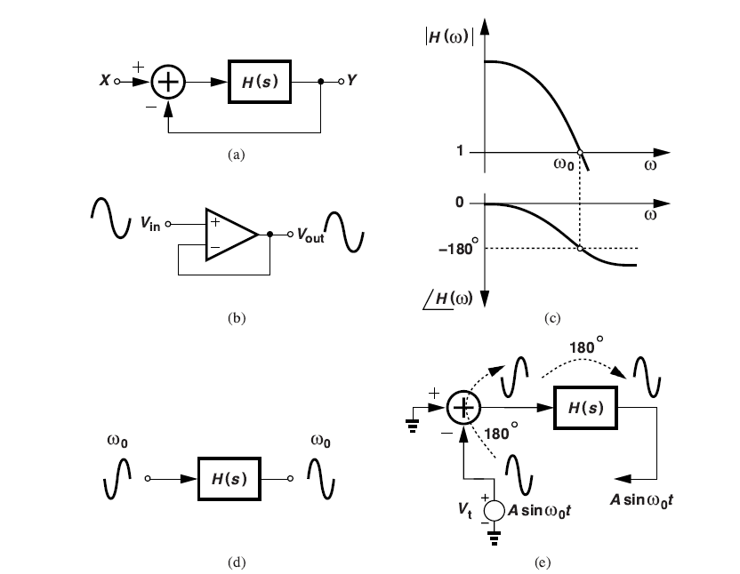
Simple feedback system:
Signal traverses amplifier and feedback block; phase goes to 180° at key frequency and returns around the loop, growing if conditions are right.
In the op-amp example, feedback is negative at low frequencies but can become positive if phase/gain criteria are met, causing oscillation.
Plots show gain/phase versus frequency; at the oscillation point, the phase crosses 180° and gain is unity, matching Barkhausen conditions.

Slide 13
Barkhausen's Criteria & Oscillatory Feedback
Core Insight: Oscillation in electronic circuits emerges not just from periodic energy cycling (as in mechanical analogies), but from a feedback loop set by Barkhausen’s criteria. When the gain and phase conditions are just right at a particular frequency, even infinitesimal noise or input is amplified, causing sustained oscillations.
Physical Intuition: The feedback acts like a "push" at just the right phase and amplitude, so each cycle is reinforced, just as gentle, correctly timed pushes keep a pendulum swinging

Slide 14
Ocillatory Feedback System: Intuitive Understanding
1. Understanding Negative Feedback Leading to Oscillation
  Unlike typical negative feedback that stabilizes amplifiers, under specific conditions, negative feedback can become unstable and produce oscillations.
  This happens when the system "fights itself" in just the right way to create sustained periodic behavior.

Slide 15
Figure 1.2(a): Shows a basic negative feedback system where the output is subtracted from the input. The negative sign at the summer indicates phase inversion.
Figure 1.2(b): An op-amp implementation where the inverting input creates the necessary 180° phase shift for negative feedback.
Figure 1.2(c): The frequency response plot showing how phase margin decreases with frequency. When phase reaches -180°, the "negative" feedback becomes "positive" feedback, potentially causing oscillation.
Figure 1.2(d) & (e): Shows signal propagation around the loop. At the oscillation frequency ω₀, a sinusoid experiences 360° total phase shift (180° from amplifier + 180° from feedback), making it return in-phase and reinforcing itself.
Figure 1.2 (a) Simple feedback system, (b) realization using an op amp, (c) open-loop frequency response showing zero phase margin, (d) signal inversion at ω0, and (e) propagation of a sinusoid at ω0 around the loop.

Slide 16
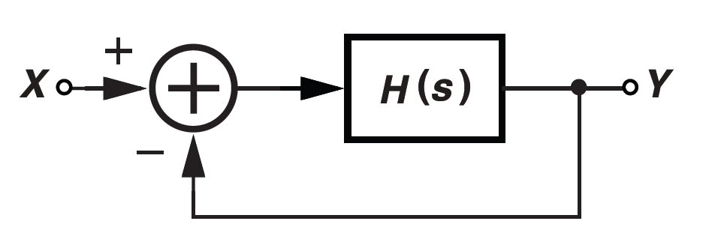
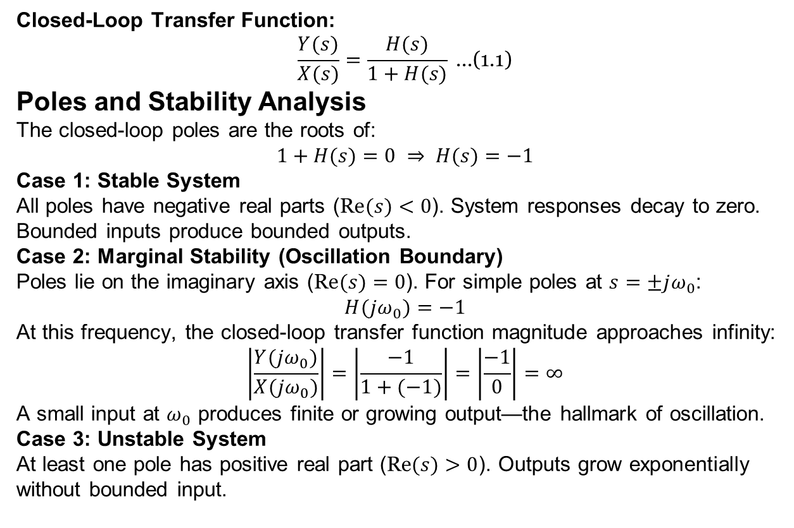
Deep Dive
Closed-Loop Transfer Function:
$$\frac{Y(s)}{X(s)}=\frac{H(s)}{1+H(s)} \text{...(1.1)}$$
Poles and Stability Analysis
The closed-loop poles are the roots of:
$$1+H(s)=0 ⇒ H(s)=−1$$
Case 1: Stable System
All poles have negative real parts ($\text{Re}(s)<0$). System responses decay to zero. Bounded inputs produce bounded outputs.
Case 2: Marginal Stability (Oscillation Boundary)
Poles lie on the imaginary axis ($\text{Re}(s)=0$). For simple poles at $s=±jω_{0}$:
$$H(jω_{0})=−1$$
At this frequency, the closed-loop transfer function magnitude approaches infinity:
$$\left|\frac{Y(jω_{0})}{X(jω_{0})}\right|=\left|\frac{−1}{1+(−1)}\right|=\left|\frac{−1}{0}\right|=∞$$
A small input at $ω_{0}$ produces finite or growing output—the hallmark of oscillation.
Case 3: Unstable System
At least one pole has positive real part ($\text{Re}(s)>0$). Outputs grow exponentially without bounded input.

Slide 17
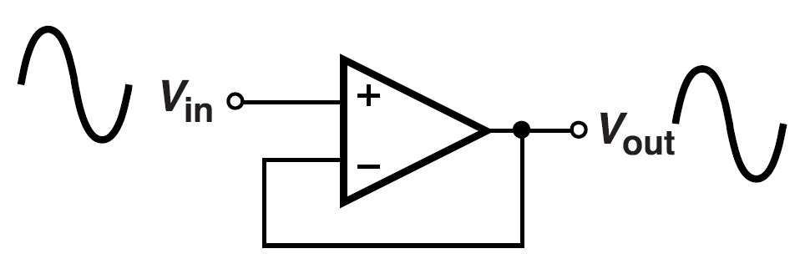
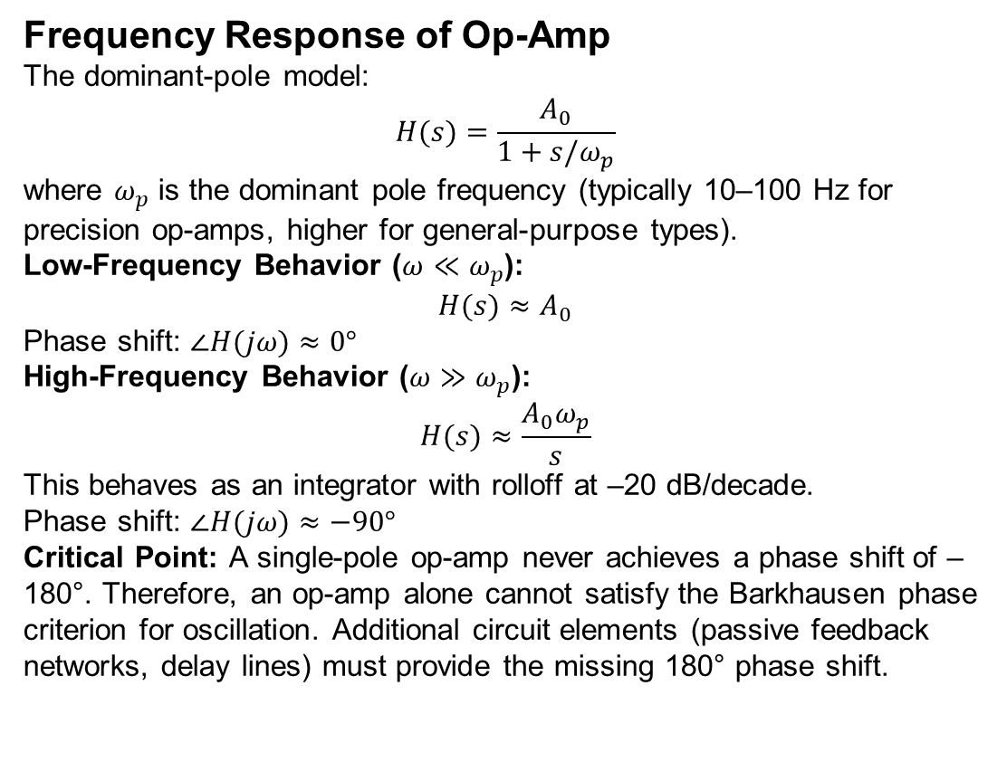
Cont..
Frequency Response of Op-Amp
The dominant-pole model:
$$H(s)=\frac{A_{0}}{1+s/ω_{p}}$$
where $ω_{p}$ is the dominant pole frequency (typically 10–100 Hz for precision op-amps, higher for general-purpose types).
Low-Frequency Behavior ($ω≪ω_{p}$):
$$H(s)≈A_{0}$$
Phase shift: $∠H(jω)≈0°$
High-Frequency Behavior ($ω≫ω_{p}$):
$$H(s)≈\frac{A_{0}ω_{p}}{s}$$
This behaves as an integrator with rolloff at –20 dB/decade.
Phase shift: $∠H(jω)≈−90°$
Critical Point: A single-pole op-amp never achieves a phase shift of –180°. Therefore, an op-amp alone cannot satisfy the Barkhausen phase criterion for oscillation. Additional circuit elements (passive feedback networks, delay lines) must provide the missing 180° phase shift.

Slide 18
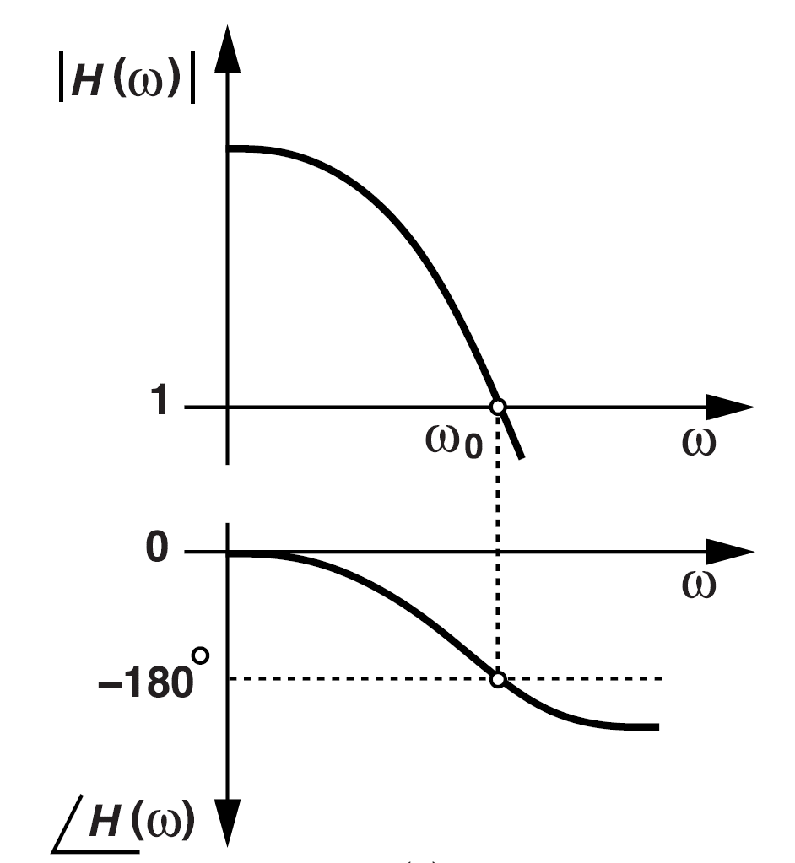
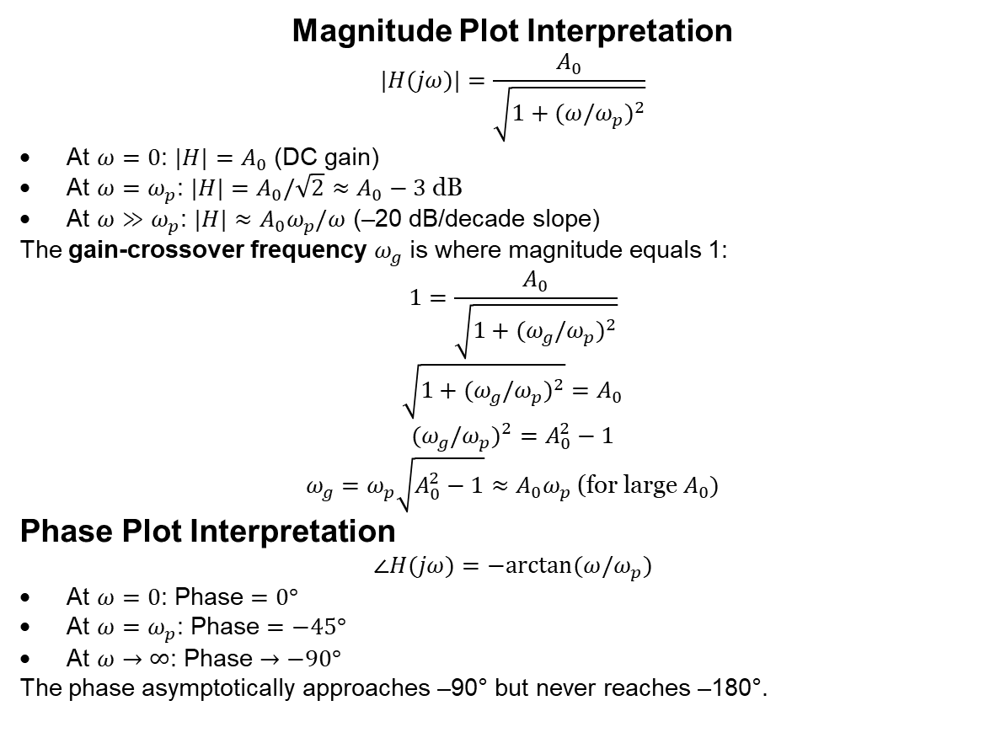
Cont..
Magnitude Plot Interpretation
$$|H(jω)|=\frac{A_{0}}{\sqrt{1+(ω/ω_{p})^{2}}}$$
At $ω=0$: $|H|=A_{0}$ (DC gain)
At $ω=ω_{p}$: $|H|=A_{0}/\sqrt{2}≈A_{0}−3 \text{dB}$
At $ω≫ω_{p}$: $|H|≈A_{0}ω_{p}/ω$ (–20 dB/decade slope)
The gain-crossover frequency $ω_{g}$ is where magnitude equals 1:
$$1=\frac{A_{0}}{\sqrt{1+(ω_{g}/ω_{p})^{2}}}$$
$$\sqrt{1+(ω_{g}/ω_{p})^{2}}=A_{0}$$
$$(ω_{g}/ω_{p})^{2}=A_{0}^{2}−1$$
$$ω_{g}=ω_{p}\sqrt{A_{0}^{2}−1}≈A_{0}ω_{p} \text{(}\text{for} \text{large} A_{0})$$
Phase Plot Interpretation
$$∠H(jω)=−arctan⁡(ω/ω_{p})$$
At $ω=0$: Phase $=0°$
At $ω=ω_{p}$: Phase $=−45°$
At $ω→∞$: Phase $→−90°$
The phase asymptotically approaches –90° but never reaches –180°.

Slide 19
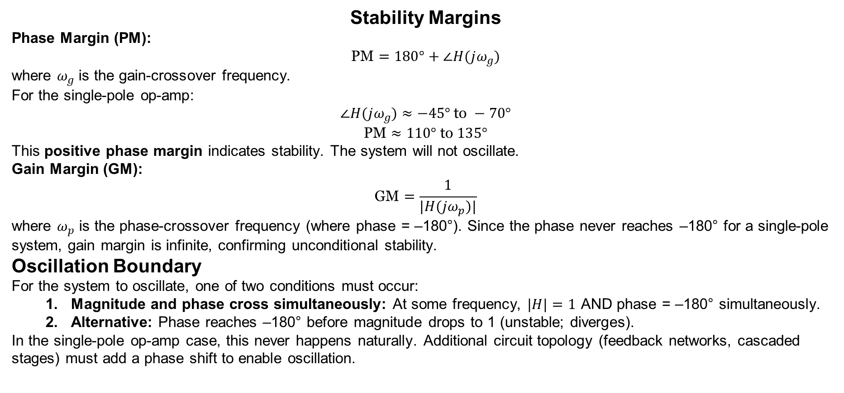
Cont..
Stability Margins
Phase Margin (PM):
$$\text{PM}=180°+∠H(jω_{g})$$
where $ω_{g}$ is the gain-crossover frequency.
For the single-pole op-amp:
$$∠H(jω_{g})≈−45° \text{to} −70°$$
$$\text{PM}≈110° \text{to} 135°$$
This positive phase margin indicates stability. The system will not oscillate.
Gain Margin (GM):
$$\text{GM}=\frac{1}{|H(jω_{p})|}$$
where $ω_{p}$ is the phase-crossover frequency (where phase = –180°). Since the phase never reaches –180° for a single-pole system, gain margin is infinite, confirming unconditional stability.
Oscillation Boundary
For the system to oscillate, one of two conditions must occur:
  Magnitude and phase cross simultaneously: At some frequency, $|H|=1$ AND phase = –180° simultaneously.
  Alternative: Phase reaches –180° before magnitude drops to 1 (unstable; diverges).
In the single-pole op-amp case, this never happens naturally. Additional circuit topology (feedback networks, cascaded stages) must add a phase shift to enable oscillation.

Slide 20
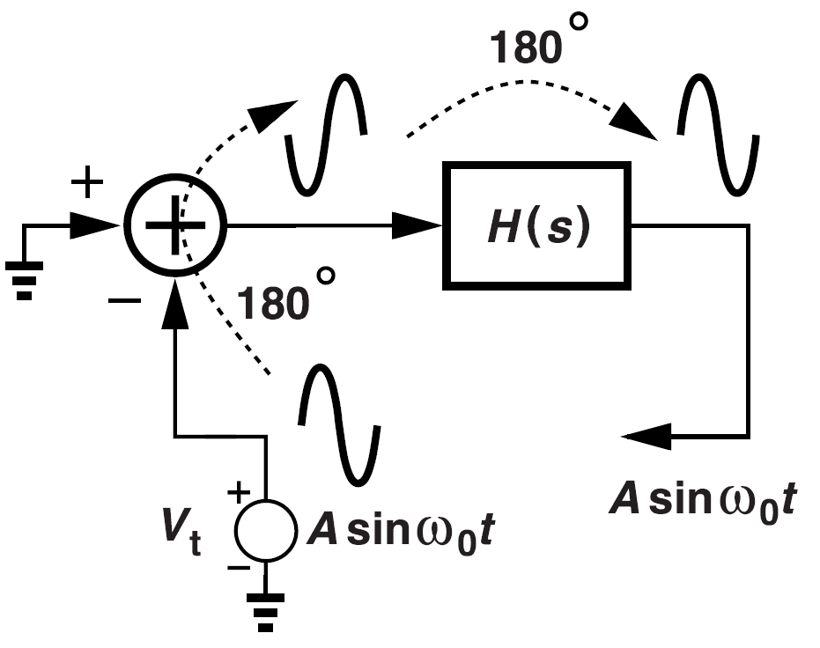
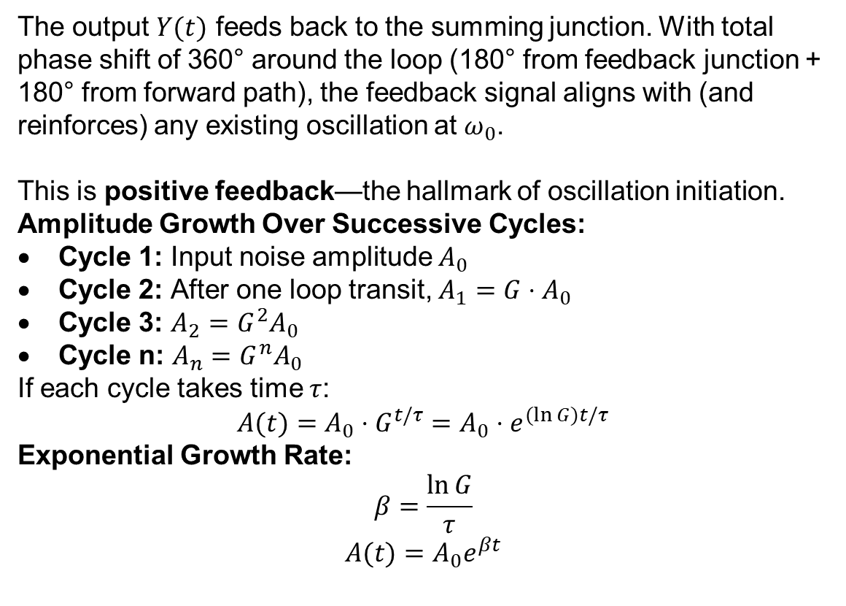
Cont..
The output $Y(t)$ feeds back to the summing junction. With total phase shift of 360° around the loop (180° from feedback junction + 180° from forward path), the feedback signal aligns with (and reinforces) any existing oscillation at $ω_{0}$.
This is positive feedback—the hallmark of oscillation initiation.
Amplitude Growth Over Successive Cycles:
Cycle 1: Input noise amplitude $A_{0}$
Cycle 2: After one loop transit, $A_{1}=G⋅A_{0}$
Cycle 3: $A_{2}=G^{2}A_{0}$
Cycle n: $A_{n}=G^{n}A_{0}$
If each cycle takes time $τ$:
$$A(t)=A_{0}⋅G^{t/τ}=A_{0}⋅e^{(ln⁡G)t/τ}$$
Exponential Growth Rate:
$$β=\frac{ln⁡G}{τ}$$
$$A(t)=A_{0}e^{βt}$$

Slide 21
2. Barkhausen Criteria: The Mathematical Foundation
The Barkhausen stability criterion provides two essential conditions for sustained oscillation:
Loop gain magnitude: |H(jω₀)| = 1 (unity gain)
Phase condition: ∠H(jω₀) = 180° (or multiples of 360°)
  Intuitive Meaning:
  At the oscillation frequency, the signal must return to its starting point with the same amplitude (condition 1) and same phase (condition 2) to reinforce itself indefinitely.
  Startup Condition:
  Initially, |H(jω₀)| > 1 to overcome losses and build up oscillation amplitude. Once steady-state is reached, nonlinear effects (saturation) automatically adjust the gain to exactly unity

Slide 22
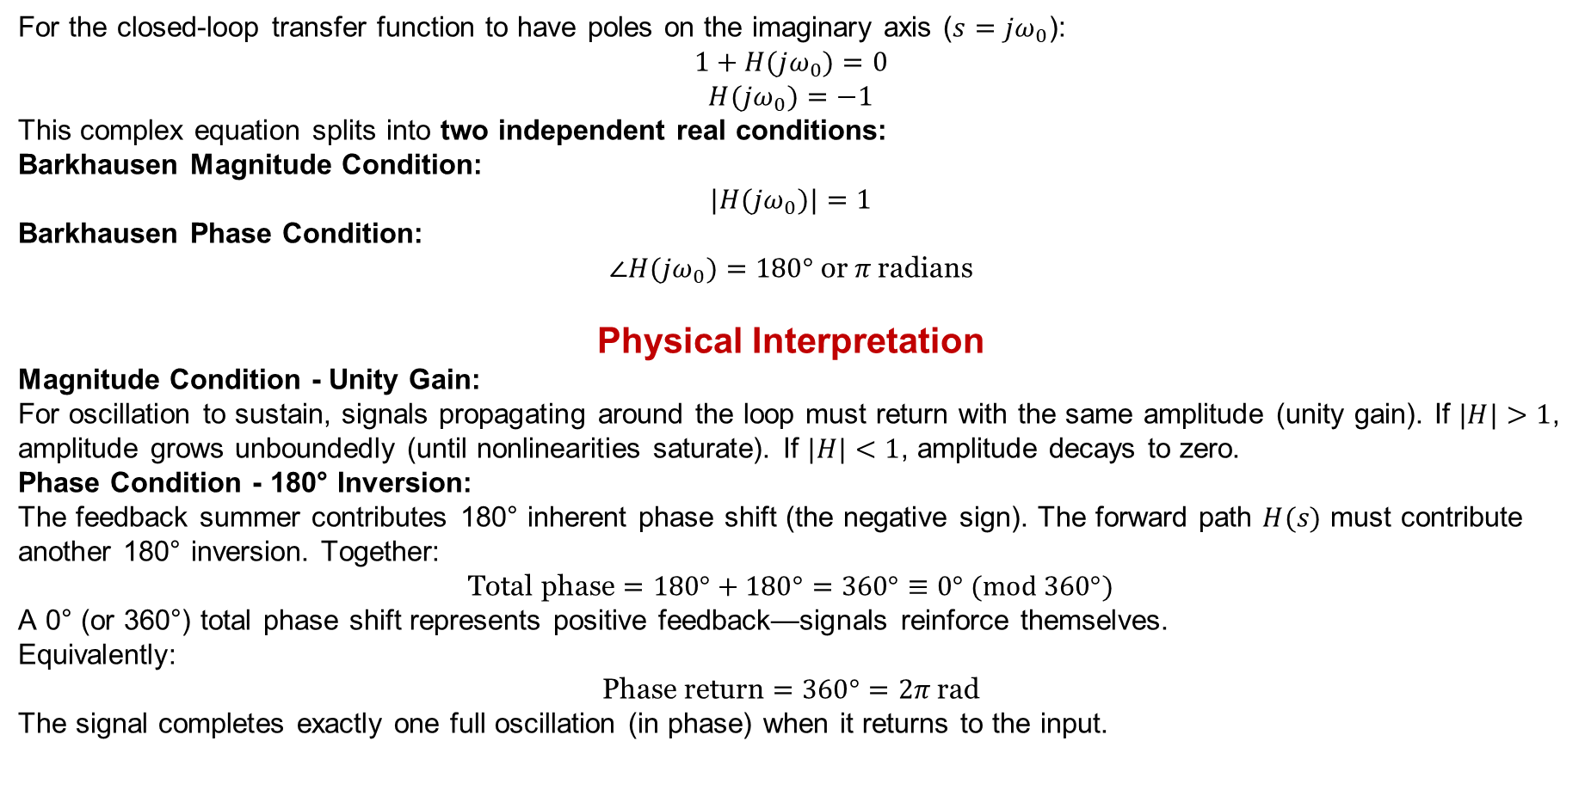
Condition for Marginally Stable Oscillation
For the closed-loop transfer function to have poles on the imaginary axis ($s=jω_{0}$):
$$1+H(jω_{0})=0$$
$$H(jω_{0})=−1$$
This complex equation splits into two independent real conditions:
Barkhausen Magnitude Condition:
$$|H(jω_{0})|=1$$
Barkhausen Phase Condition:
$$∠H(jω_{0})=180° \text{or} π \text{radians}$$
Physical Interpretation
Magnitude Condition - Unity Gain:
For oscillation to sustain, signals propagating around the loop must return with the same amplitude (unity gain). If $|H|>1$, amplitude grows unboundedly (until nonlinearities saturate). If $|H|<1$, amplitude decays to zero.
Phase Condition - 180° Inversion:
The feedback summer contributes 180° inherent phase shift (the negative sign). The forward path $H(s)$ must contribute another 180° inversion. Together:
$$\text{Total} \text{phase}=180°+180°=360°≡0° (mod 360°)$$
A 0° (or 360°) total phase shift represents positive feedback—signals reinforce themselves.
Equivalently:
$$\text{Phase} \text{return}=360°=2π \text{rad}$$
The signal completes exactly one full oscillation (in phase) when it returns to the input.

Slide 23
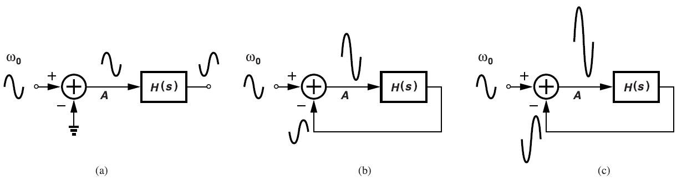
3. Oscillation Growth Mechanism
Figure 1.3 Growth of an input sinusoid around the loop with time.
Figure 1.3(a): Shows the open-loop case where a small input creates a corresponding output.
Figure 1.3(b): When the loop is closed, the output gets subtracted from input, creating a larger net signal that gets amplified further.
Figure 1.3(c): Shows exponential growth - each trip around the loop amplifies the signal more, leading to indefinite growth if unchecked.
Key Insight: This demonstrates how positive loop gain (when |H(jω)| > 1) causes amplitude bildup, while the phase condition ensures the signal reinforces rather than cancels itself.

Slide 24
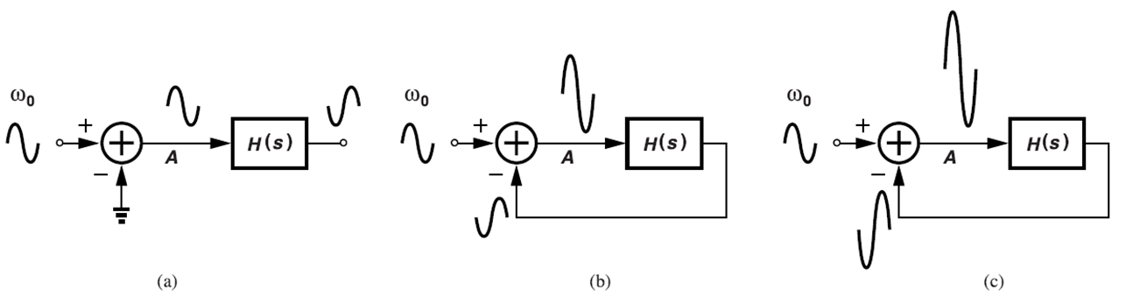
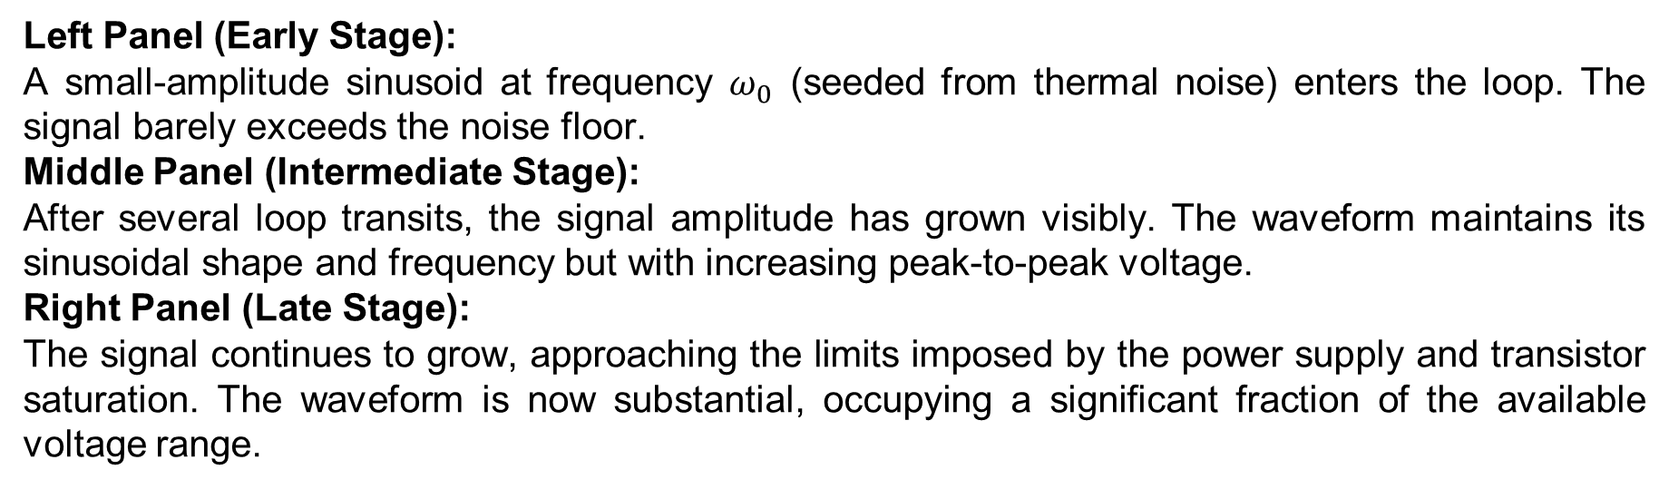
Left Panel (Early Stage):
A small-amplitude sinusoid at frequency $ω_{0}$ (seeded from thermal noise) enters the loop. The signal barely exceeds the noise floor.
Middle Panel (Intermediate Stage):
After several loop transits, the signal amplitude has grown visibly. The waveform maintains its sinusoidal shape and frequency but with increasing peak-to-peak voltage.
Right Panel (Late Stage):
The signal continues to grow, approaching the limits imposed by the power supply and transistor saturation. The waveform is now substantial, occupying a significant fraction of the available voltage range.

Slide 25
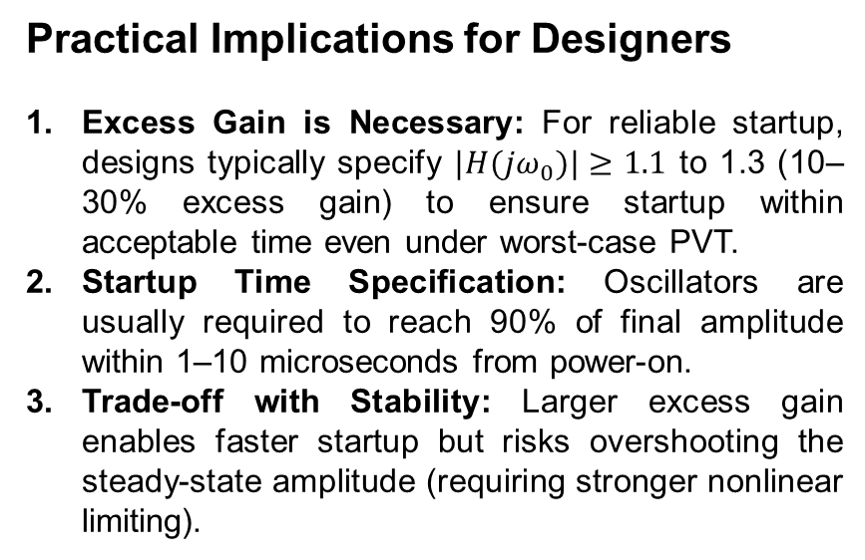
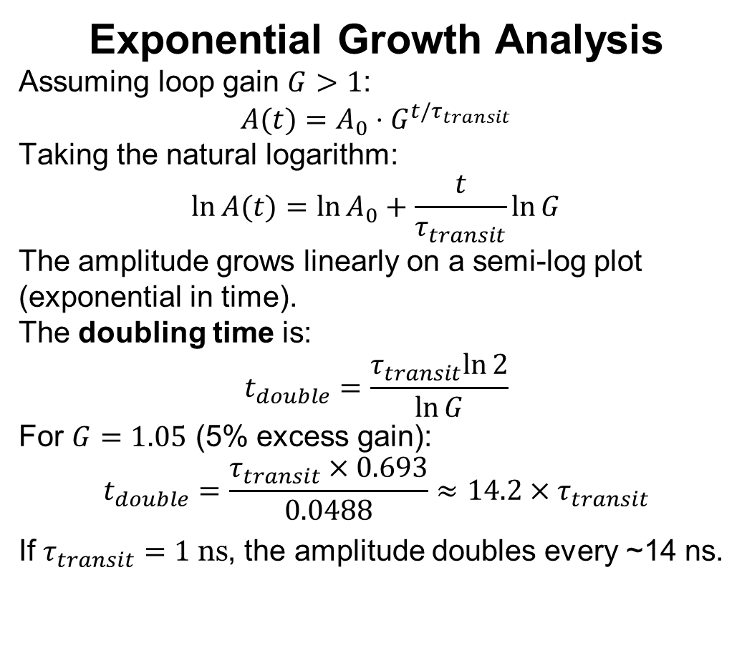
Cont..
Exponential Growth Analysis
Assuming loop gain $G>1$:
$$A(t)=A_{0}⋅G^{t/τ_{transit}}$$
Taking the natural logarithm:
$$ln⁡A(t)=ln⁡A_{0}+\frac{t}{τ_{transit}}ln⁡G$$
The amplitude grows linearly on a semi-log plot (exponential in time).
The doubling time is:
$$t_{double}=\frac{τ_{transit}ln⁡2}{ln⁡G}$$
For $G=1.05$ (5% excess gain):
$$t_{double}=\frac{τ_{transit}×0.693}{0.0488}≈14.2×τ_{transit}$$
If $τ_{transit}=1 \text{ns}$, the amplitude doubles every ~14 ns.
Practical Implications for Designers
Excess Gain is Necessary: For reliable startup, designs typically specify $|H(jω_{0})|≥1.1$ to 1.3 (10–30% excess gain) to ensure startup within acceptable time even under worst-case PVT.
Startup Time Specification: Oscillators are usually required to reach 90% of final amplitude within 1–10 microseconds from power-on.
Trade-off with Stability: Larger excess gain enables faster startup but risks overshooting the steady-state amplitude (requiring stronger nonlinear limiting).

Slide 26
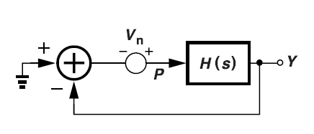
4. Noise-Initiated Oscillation
Figure shows how wideband noise within the system provides the initial "seed" for oscillation.
Even with no external input, internal noise contains components at all frequencies, including ω₀.
Practical Reality: Real oscillators don't need external signals - they self-start from noise because:
Thermal noise in resistors
Shot noise in active devices
Power supply fluctuations
All provide sufficient energy at ω₀ to initiate oscillation when Barkhausen conditions are met.
Figure 1.4 Effect of noise injected into a closed-loop system.

Slide 27
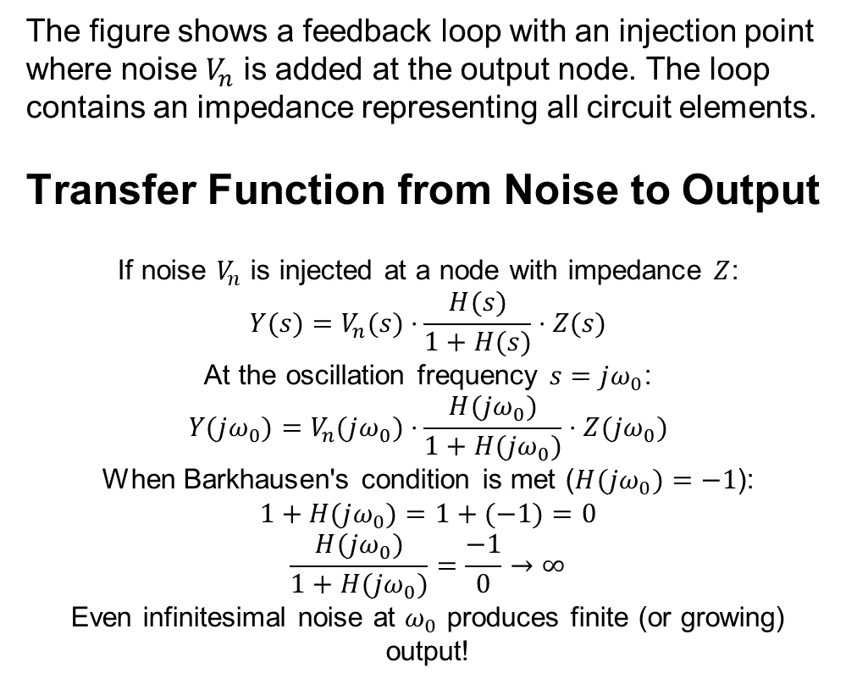
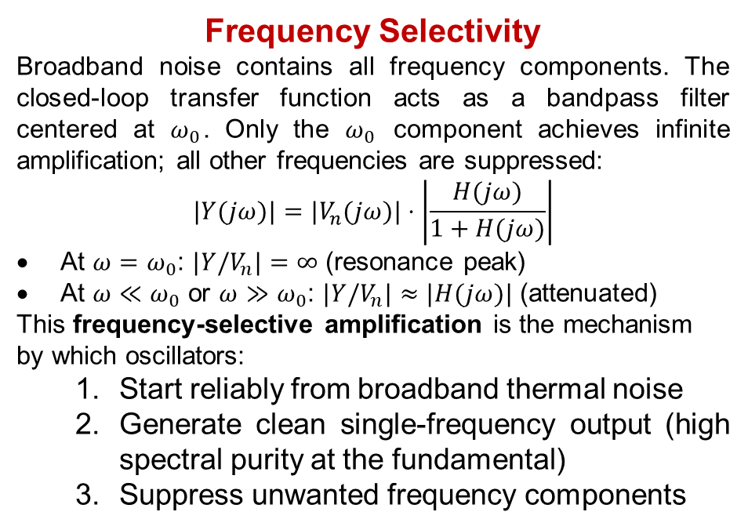
Circuit Configuration
The figure shows a feedback loop with an injection point where noise $V_{n}$ is added at the output node. The loop contains an impedance representing all circuit elements.
Transfer Function from Noise to Output
If noise $V_{n}$ is injected at a node with impedance $Z$:
$$Y(s)=V_{n}(s)⋅\frac{H(s)}{1+H(s)}⋅Z(s)$$
At the oscillation frequency $s=jω_{0}$:
$$Y(jω_{0})=V_{n}(jω_{0})⋅\frac{H(jω_{0})}{1+H(jω_{0})}⋅Z(jω_{0})$$
When Barkhausen's condition is met ($H(jω_{0})=−1$):
$$1+H(jω_{0})=1+(−1)=0$$
$$\frac{H(jω_{0})}{1+H(jω_{0})}=\frac{−1}{0}→∞$$
Even infinitesimal noise at $ω_{0}$ produces finite (or growing) output!
Frequency Selectivity
Broadband noise contains all frequency components. The closed-loop transfer function acts as a bandpass filter centered at $ω_{0}$. Only the $ω_{0}$ component achieves infinite amplification; all other frequencies are suppressed:
$$|Y(jω)|=|V_{n}(jω)|⋅\left|\frac{H(jω)}{1+H(jω)}\right|$$
At $ω=ω_{0}$: $|Y/V_{n}|=∞$ (resonance peak)
At $ω≪ω_{0}$ or $ω≫ω_{0}$: $|Y/V_{n}|≈|H(jω)|$ (attenuated)
This frequency-selective amplification is the mechanism by which oscillators:
  Start reliably from broadband thermal noise
  Generate clean single-frequency output (high spectral purity at the fundamental)
  Suppress unwanted frequency components

Slide 28
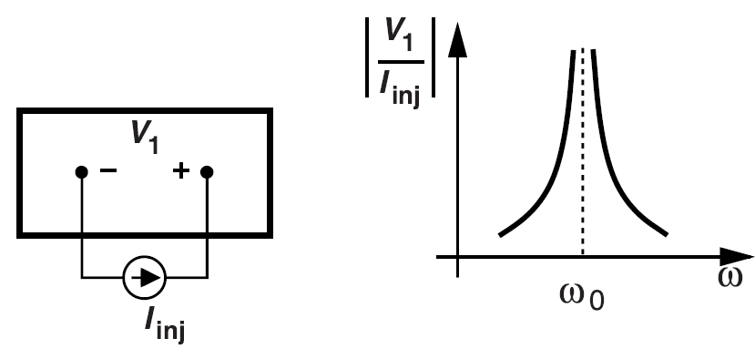
5. Impedance Perspective
Figure shows the impedance method for finding oscillation conditions.
When a current I_{inj} is injected at frequency ω₀ into a node, if the resulting voltage goes to infinity, the circuit can oscillate at that frequency.
This happens when the input impedance becomes infinite (or equivalently, negative resistance balances losses).
Connection to Barkhausen: This impedance approach is mathematically equivalent to the Barkhausen criterion but provides a different intuitive perspective - oscillation occurs when the active circuit exactly cancels the passive losses.
Figure 1.5 Infinite port impedance in an oscillatory circuit.

Slide 29
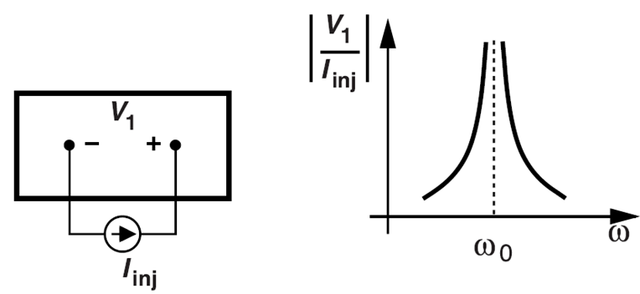
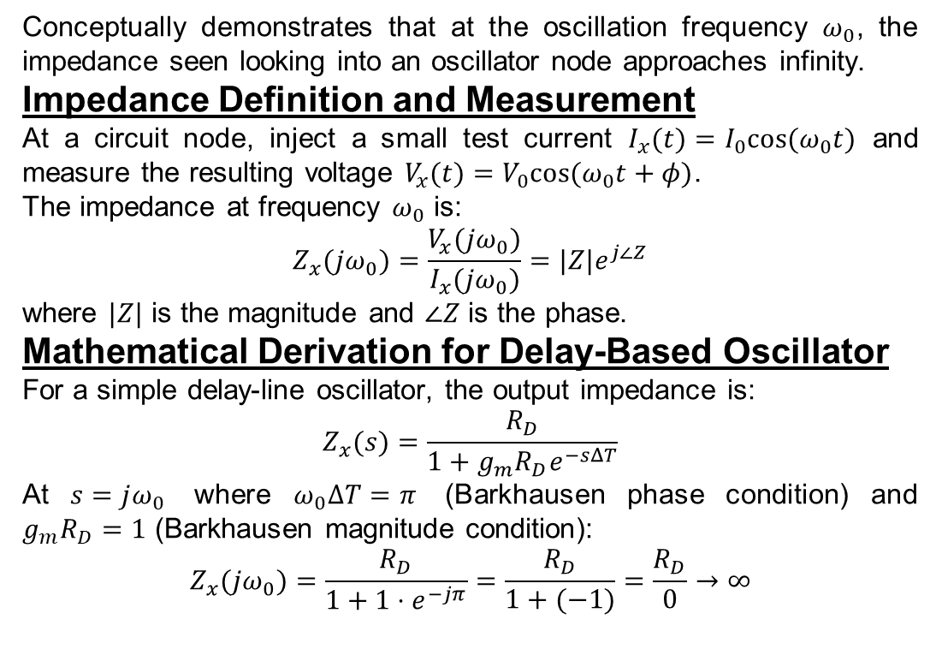
Infinite Port Impedance at Oscillation Frequency
Conceptually demonstrates that at the oscillation frequency $ω_{0}$, the impedance seen looking into an oscillator node approaches infinity.
Impedance Definition and Measurement
At a circuit node, inject a small test current $I_{x}(t)=I_{0}cos⁡(ω_{0}t)$ and measure the resulting voltage $V_{x}(t)=V_{0}cos⁡(ω_{0}t+φ)$.
The impedance at frequency $ω_{0}$ is:
$$Z_{x}(jω_{0})=\frac{V_{x}(jω_{0})}{I_{x}(jω_{0})}=|Z|e^{j∠Z}$$
where $|Z|$ is the magnitude and $∠Z$ is the phase.
Mathematical Derivation for Delay-Based Oscillator
For a simple delay-line oscillator, the output impedance is:
$$Z_{x}(s)=\frac{R_{D}}{1+g_{m}R_{D}e^{−sΔT}}$$
At $s=jω_{0}$ where $ω_{0}ΔT=π$ (Barkhausen phase condition) and $g_{m}R_{D}=1$ (Barkhausen magnitude condition):
$$Z_{x}(jω_{0})=\frac{R_{D}}{1+1⋅e^{−jπ}}=\frac{R_{D}}{1+(−1)}=\frac{R_{D}}{0}→∞$$
Physical Meaning:
Infinite impedance means the node cannot absorb current (open circuit at that frequency).
A small current injection produces arbitrarily large voltage changes.
This is the resonance condition—the hallmark of oscillation.

Slide 30
Designer Application - Impedance-Based Verification
In circuit design, one can verify oscillation by:
  Breaking the feedback loop at one point (open-circuiting the connection)
  Injecting a small AC current source at that point
  Measuring the AC voltage that appears
  Computing impedance as V/I across the frequency range
The presence of a sharp impedance peak at the desired oscillation frequency confirms:
  Barkhausen's conditions are nearly satisfied
  The circuit will oscillate when the loop is closed
  The impedance peak location identifies the actual oscillation frequency

Slide 31
6.Progression: From Mechanical to Electronic
Step 1: Pendulum Analogy
  Energy cycling between potential and kinetic forms
  Natural frequency depends on system parameters (length), not amplitude
  Losses require periodic "pushes" to sustain motion
Step 2: Electronic Oscillators
  Energy cycles between electric and magnetic fields (LC) or charge storage (RC)
  Natural frequency depends on L, C, or R, C values
  Active feedback provides the "pushes" to overcome resistive losses
Step 3: PLL Connection
  PLLs use controlled oscillators (VCOs) where feedback adjusts frequency
  The "push timing" (feedback) is controlled by phase comparison
  This enables frequency locking and jitter reduction for high-performance systems

Slide 32
7. Stability vs. Oscillation: The Fine Line
Key Insight: The difference between a stable amplifier and an oscillator is simply the amount of loop gain and phase shift:
  Stable amplifier: Phase margin > 0°, gain margin > 0 dB
  Marginally stable: Phase margin = 0°, gain margin = 0 dB
  Oscillator: Barkhausen conditions met at desired frequency
This understanding helps students see oscillators not as mysterious circuits, but as intentionally destabilized feedback systems operating at a precisely controlled instability point.
Bottom Line: Oscillation is controlled instability - we deliberately create conditions where the system cannot settle to a DC value but instead perpetually cycles at a predictable frequency and amplitude

Slide 33
Oscillator Analysis Methods: From Fundamentals to Real Circuit Design
Understanding the Three Analysis Methods
The text presents three fundamental approaches to oscillator analysis, each offering unique insights into how circuits achieve sustained oscillation.
Method 1: Open-Loop Analysis (Break the Loop)
Fundamental Concept: Remove the feedback connection and apply the Barkhausen criteria directly.
Teaching Analogy: Like checking if a microphone-speaker system will cause feedback by measuring how loud the speaker gets when you whisper into the microphone.
Mathematical Foundation:
Set H(jω₀) = -1 for oscillation
This gives us both frequency (where phase = 180°) and gain requirements (|H| = 1)
Method 2: Time-Domain Initial Condition
Fundamental Concept: Like the "lossless pendulum" - give the system a small "push" and see if oscillations grow.
Physical Meaning: Start with energy stored somewhere (charged capacitor, current in inductor) and analyze if the energy transfer sustains or decays.
Method 3: Impedance/Admittance Analysis
Fundamental Concept: Inject a test signal and find where impedance goes to infinity (or becomes negative).
Intuitive Understanding: When input impedance becomes infinite, it means the circuit can sustain voltage/current without external drive - this is oscillation

Slide 34
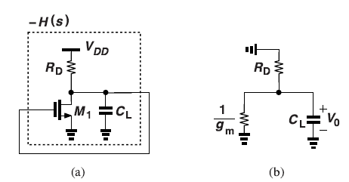
Common Source (CS) Stage Analysis
Figure (a): Shows a common-source MOSFET with feedback from drain to gate through a capacitor CL.
Figure (b): Equivalent small-signal model showing transconductance gm and load capacitor.
Why This Circuit Cannot Oscillate:
  Fundamental Issue: The CS stage only provides 90° maximum phase shift at high frequencies, but oscillation requires 180°.
Mathematical Proof:
  Transfer function: H(s) = g_{m}(R_{D} || 1/sC_{L}) = g_{m}R_{D}/(1 + sR_{D}C_{L})
  This single-pole system can only contribute up to 90° phase shift
  Barkhausen criterion requires 180° total, so oscillation is impossible
(a) Feedback around a CS stage, and (b) equivalent circuit.
Teaching Insight: This demonstrates why simple amplifier stages need additional phase-shifting networks to become oscillators

Slide 35
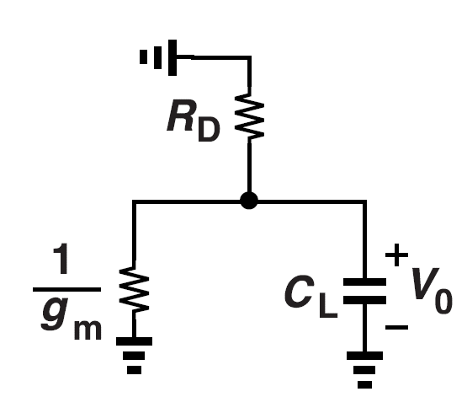
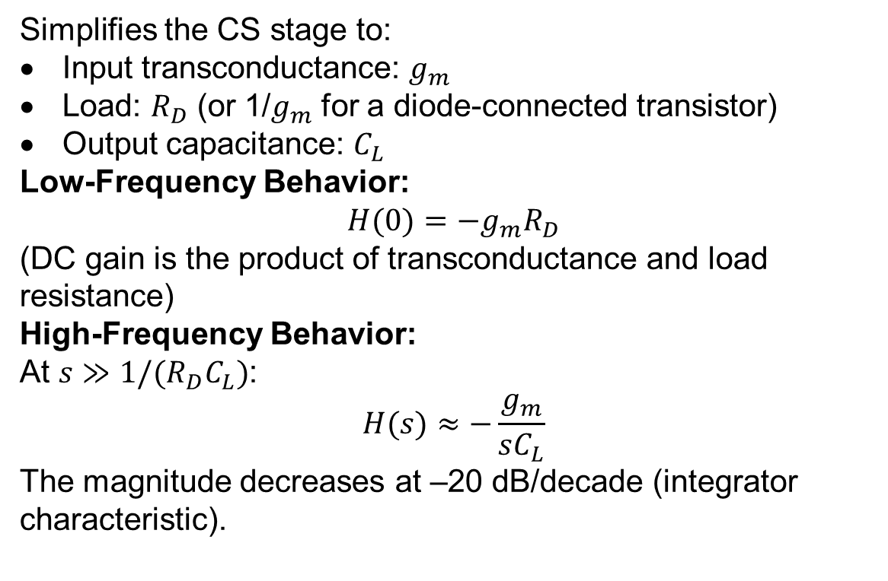
Cont..
Simplifies the CS stage to:
Input transconductance: $g_{m}$
Load: $R_{D}$ (or 1/$g_{m}$ for a diode-connected transistor)
Output capacitance: $C_{L}$
Low-Frequency Behavior:
$$H(0)=−g_{m}R_{D}$$
(DC gain is the product of transconductance and load resistance)
High-Frequency Behavior:
At $s≫1/(R_{D}C_{L})$:
$$H(s)≈−\frac{g_{m}}{sC_{L}}$$
The magnitude decreases at –20 dB/decade (integrator characteristic).

Slide 36
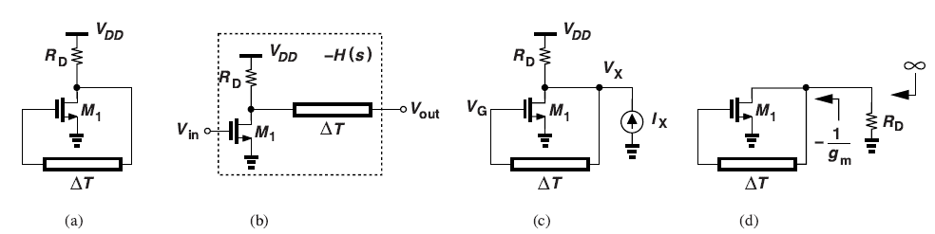
Adding Delay for Oscillation The Delay Line Solution:
  Figure (a): Shows the same CS stage with an additional delay element ΔT.
Why Delay Works:
  Delay creates frequency-dependent phase shift: φ = ωΔT
  At frequency f₀ = 1/(2ΔT), phase shift = 180°
  Combined with amplifier gain, oscillation becomes possible
Analysis:
  Figure (b): Open-loop representation showing H(s) = g_{m}R_{D}e^{(-sΔT).}
  Figure (c): Impedance analysis setup - inject current I_{X} and measure voltage V_{X}.
  Figure (d): Shows infinite impedance condition when g_{m}R_{D} = 1 and ωΔT = π.
Mathematical Results:
  Startup Condition: g_{m}R_{D} = 1 (unity loop gain)
  Frequency Condition: ω₀ΔT = π, giving f₀ = 1/(2ΔT)
  Oscillation Period: T = 2ΔT (twice the delay time)
Figure 1.7 (a) CS stage with a feedback delay line, (b) open-loop system, (c) computation of impedance at one node, and (d) illustration of infinite impedance at ω0.
Designer Insight:
The delay $ΔT$ is the primary frequency-determining element. By controlling delay (through RC time constants or explicit delay-line length), the designer directly sets the oscillation frequency.

Slide 37
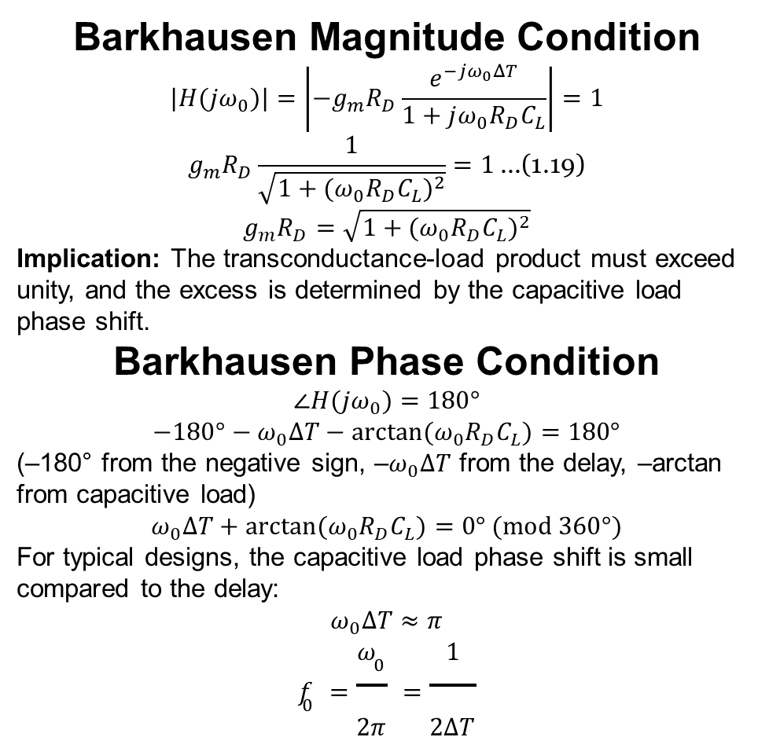
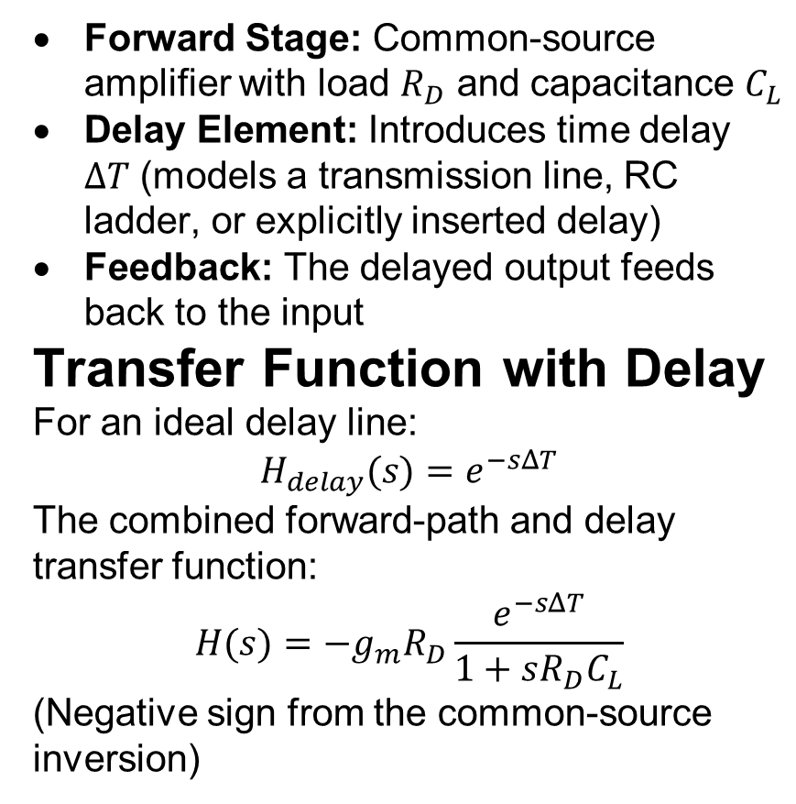
Circuit Configuration
Forward Stage: Common-source amplifier with load $R_{D}$ and capacitance $C_{L}$
Delay Element: Introduces time delay $ΔT$ (models a transmission line, RC ladder, or explicitly inserted delay)
Feedback: The delayed output feeds back to the input
Transfer Function with Delay
For an ideal delay line:
$$H_{delay}(s)=e^{−sΔT}$$
The combined forward-path and delay transfer function:
$$H(s)=−g_{m}R_{D}\frac{e^{−sΔT}}{1+sR_{D}C_{L}}$$
(Negative sign from the common-source inversion)
Barkhausen Magnitude Condition
$$|H(jω_{0})|=\left|−g_{m}R_{D}\frac{e^{−jω_{0}ΔT}}{1+jω_{0}R_{D}C_{L}}\right|=1$$
$$g_{m}R_{D}\frac{1}{\sqrt{1+(ω_{0}R_{D}C_{L})^{2}}}=1 \text{...(1.19)}$$
$$g_{m}R_{D}=\sqrt{1+(ω_{0}R_{D}C_{L})^{2}}$$
Implication: The transconductance-load product must exceed unity, and the excess is determined by the capacitive load phase shift.
Barkhausen Phase Condition
$$∠H(jω_{0})=180°$$
$$−180°−ω_{0}ΔT−arctan⁡(ω_{0}R_{D}C_{L})=180°$$
(–180° from the negative sign, –$ω_{0}ΔT$ from the delay, –arctan from capacitive load)
$$ω_{0}ΔT+arctan⁡(ω_{0}R_{D}C_{L})=0° (mod 360°)$$
For typical designs, the capacitive load phase shift is small compared to the delay:
$$ω_{0}ΔT≈π$$
$$f_{0}=\frac{ω_{0}}{2π}=\frac{1}{2ΔT}$$

Slide 38
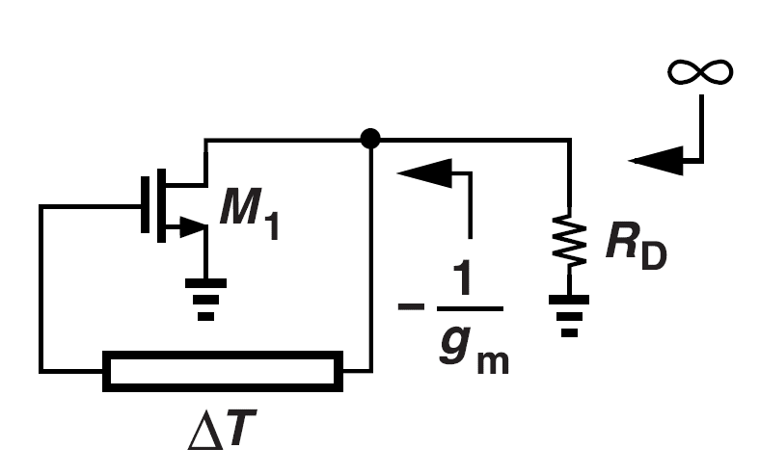
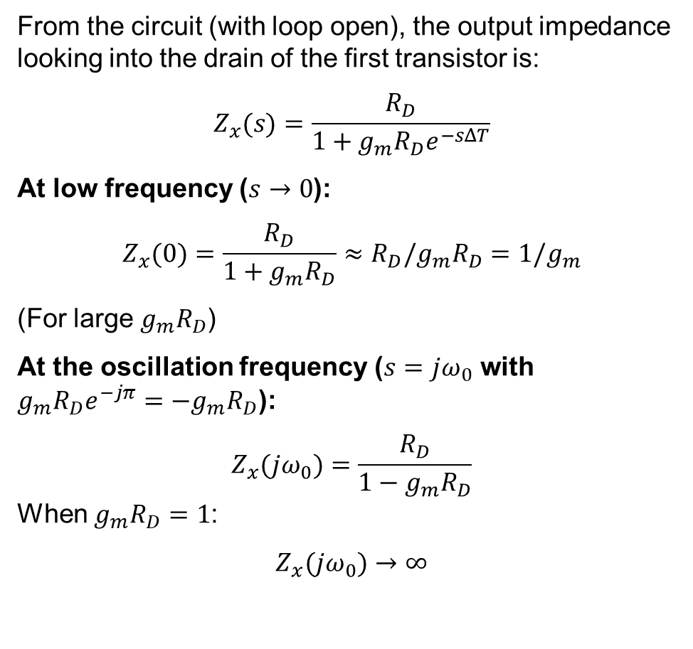
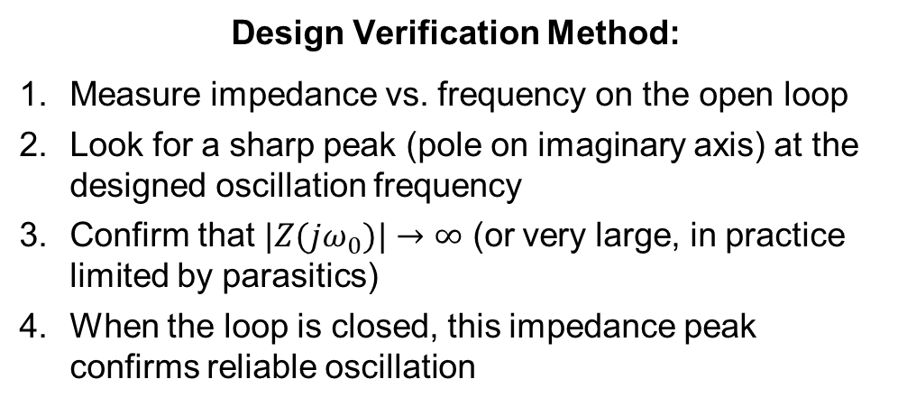
Output Impedance Calculation
From the circuit (with loop open), the output impedance looking into the drain of the first transistor is:
$$Z_{x}(s)=\frac{R_{D}}{1+g_{m}R_{D}e^{−sΔT}}$$
At low frequency ($s→0$):
$$Z_{x}(0)=\frac{R_{D}}{1+g_{m}R_{D}}≈R_{D}/g_{m}R_{D}=1/g_{m}$$
(For large $g_{m}R_{D}$)
At the oscillation frequency ($s=jω_{0}$ with $g_{m}R_{D}e^{−jπ}=−g_{m}R_{D}$):
$$Z_{x}(jω_{0})=\frac{R_{D}}{1−g_{m}R_{D}}$$
When $g_{m}R_{D}=1$:
$$Z_{x}(jω_{0})→∞$$
Design Verification Method:
Measure impedance vs. frequency on the open loop
Look for a sharp peak (pole on imaginary axis) at the designed oscillation frequency
Confirm that $|Z(jω_{0})|→∞$ (or very large, in practice limited by parasitics)
When the loop is closed, this impedance peak confirms reliable oscillation

Slide 39
Fundamental Insights
1. Energy Perspective (Connecting to Pendulum)
  CS amplifier alone: Can amplify but cannot store and release energy cyclically
  With delay: Creates energy storage mechanism (signals "travel" through delay, get amplified, travel back)
  Like pendulum: Delay provides the "swing time" while amplifier provides the "push"
2. Phase Shift Perspective
  Single amplifier: Limited phase shift (90° for CS stage)
  Delay element: Provides additional frequency-dependent phase shift
  Total system: Can achieve 180° at specific frequency for oscillation
3. Impedance Perspective
  Oscillation occurs: When circuit impedance becomes infinite (self-sustaining)
  Physical meaning: Circuit can maintain signals without external drive
  Mathematical condition: Denominator of impedance expression goes to zero
4. Startup vs. Steady-State
  Startup: Need gmRD > 1 to overcome losses and build amplitude
  Steady-state: Nonlinear effects reduce gain to exactly gmRD = 1
  Like pendulum: Initially push harder to build swing, then maintain with just enough energy

Slide 40
Progressive Learning Path
Step 1: Master the Pendulum Analogy
  Energy cycling between forms
  Natural frequency independent of amplitude
  Need periodic "pushes" to overcome losses
Step 2: Understand Electronic Energy Cycling
  Voltage/current oscillations in LC circuits
  Delay-based energy storage (signals traveling back and forth)
  Active feedback providing the "pushes"
Step 3: Connect to Practical Oscillators
  Ring oscillators (cascade of delay elements)
  LC oscillators (resonant energy storage)
  Crystal oscillators (mechanical resonance)
Step 4: Link to PLL Applications
  VCOs as controlled oscillators
  Phase-locked feedback for frequency control
  Jitter and stability considerations
Key Takeaway: Oscillation is controlled energy cycling where feedback timing (phase) and strength (gain) are precisely balanced to maintain sustained, predictable periodic behavior. Understanding this fundamental principle enables design of everything from simple RC oscillators to complex PLL systems

Slide 41
Fundamental Intuition for Oscillator Startup, Growth, and Topologies
Oscillators are deliberately driven to the edge of instability so that, with the right loop gain and phase shift, they transition from a stable amplifier to a self-sustaining periodic generator.
The following distilled insights and figure breakdowns provide an intuitive, energy-and-feedback view of how real circuits meet these conditions and manage startup, growth, and topology choices

Slide 42
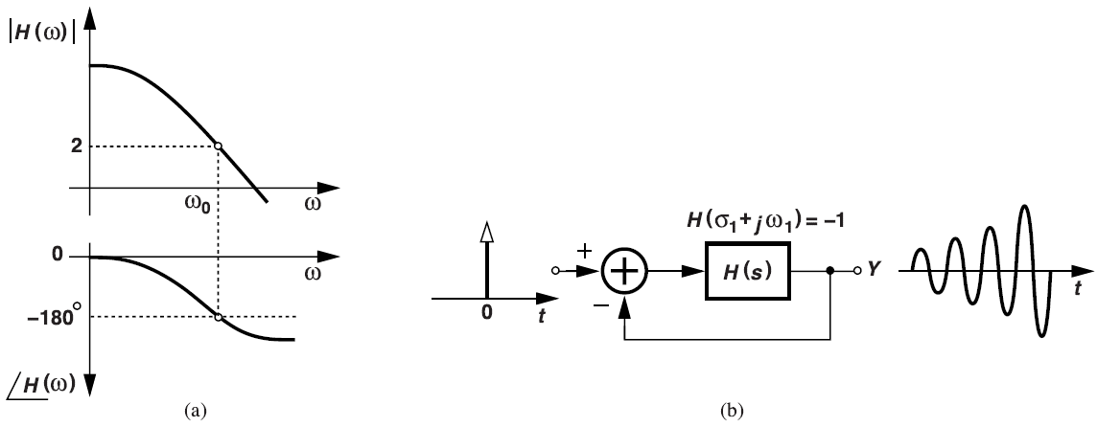
1. Startup Condition Beyond Barkhausen
Real oscillators are designed with a loop gain slightly greater than one at the desired frequency to guarantee startup despite manufacturing and environmental variations:
    |H(jω₀)|>1 ensures the initial amplitude grows from noise or a tiny perturbation.
    ∠H(jω₀)=180° still holds so that the feedback is effectively positive at ω₀.
  It depicts that when an impulse enters this marginally unstable loop, even a brief pulse blossoms into a growing sinusoid—demonstrating that startup occurs from any nonzero seed,
  It tends to not just steady‐state sinusoidal injection
  Shows an open-loop Bode plot with magnitude >2 at ω₀ and phase = –180°. Simply having |H|>1 and phase =180° at ω₀ does not guarantee the loop oscillates exactly at that frequency;
  The system actually finds a complex pole s₁ (σ₁+jω₁) satisfying H(s₁)=–1, with σ₁>0 to provide growth.
Figure 1.10 (a) Open-loop response with gain greater than unity at ω0, and (b) impulse response of closed-loop system.

Slide 43
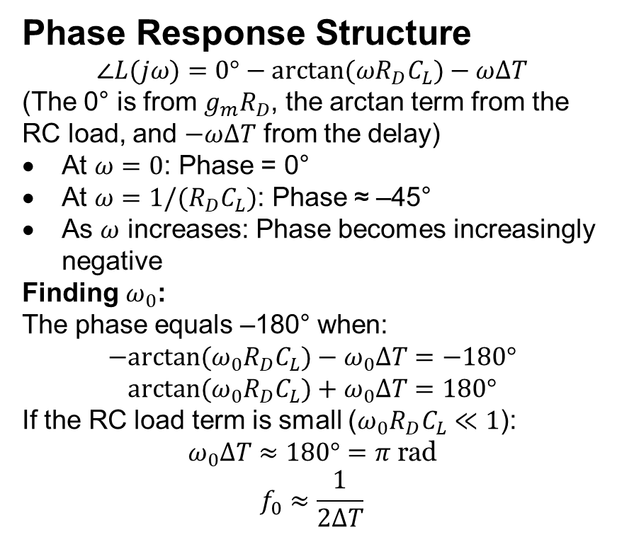
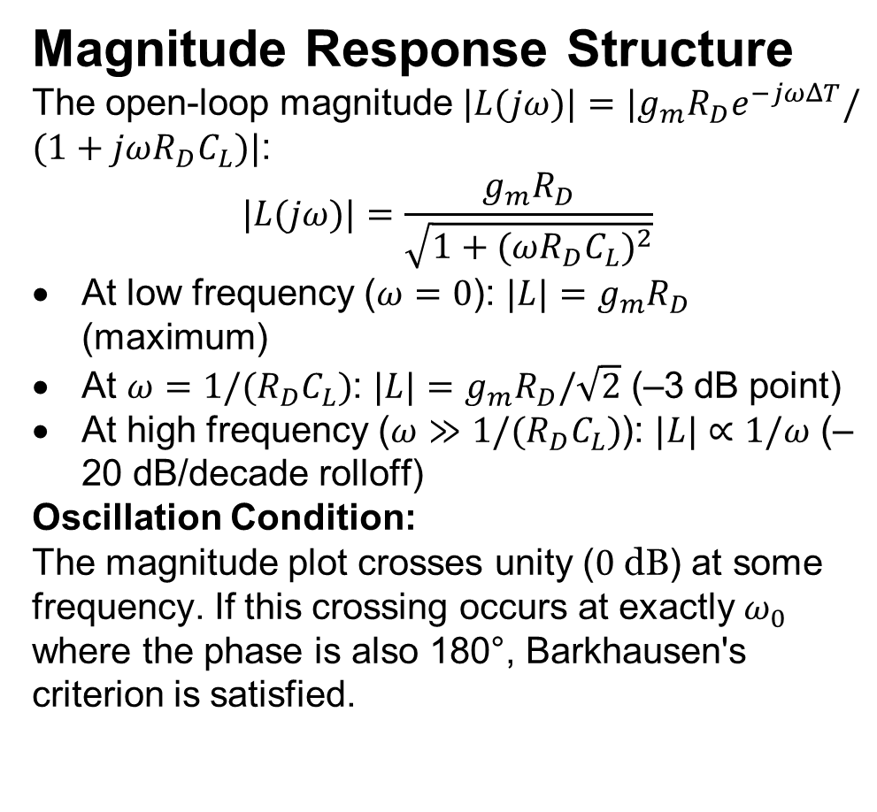
Cont..
Magnitude Response Structure
The open-loop magnitude $|L(jω)|=|g_{m}R_{D}e^{−jωΔT}/(1+jωR_{D}C_{L})|$:
$$|L(jω)|=\frac{g_{m}R_{D}}{\sqrt{1+(ωR_{D}C_{L})^{2}}}$$
At low frequency ($ω=0$): $|L|=g_{m}R_{D}$ (maximum)
At $ω=1/(R_{D}C_{L})$: $|L|=g_{m}R_{D}/\sqrt{2}$ (–3 dB point)
At high frequency ($ω≫1/(R_{D}C_{L})$): $|L|∝1/ω$ (–20 dB/decade rolloff)
Oscillation Condition:
The magnitude plot crosses unity ($0 \text{dB}$) at some frequency. If this crossing occurs at exactly $ω_{0}$ where the phase is also 180°, Barkhausen's criterion is satisfied.
Phase Response Structure
$$∠L(jω)=0°−arctan⁡(ωR_{D}C_{L})−ωΔT$$
(The 0° is from $g_{m}R_{D}$, the arctan term from the RC load, and $−ωΔT$ from the delay)
At $ω=0$: Phase = 0°
At $ω=1/(R_{D}C_{L})$: Phase ≈ –45°
As $ω$ increases: Phase becomes increasingly negative
Finding $ω_{0}$:
The phase equals –180° when:
$$−arctan⁡(ω_{0}R_{D}C_{L})−ω_{0}ΔT=−180°$$
$$arctan⁡(ω_{0}R_{D}C_{L})+ω_{0}ΔT=180°$$
If the RC load term is small ($ω_{0}R_{D}C_{L}≪1$):
$$ω_{0}ΔT≈180°=π \text{rad}$$
$$f_{0}≈\frac{1}{2ΔT}$$

Slide 44
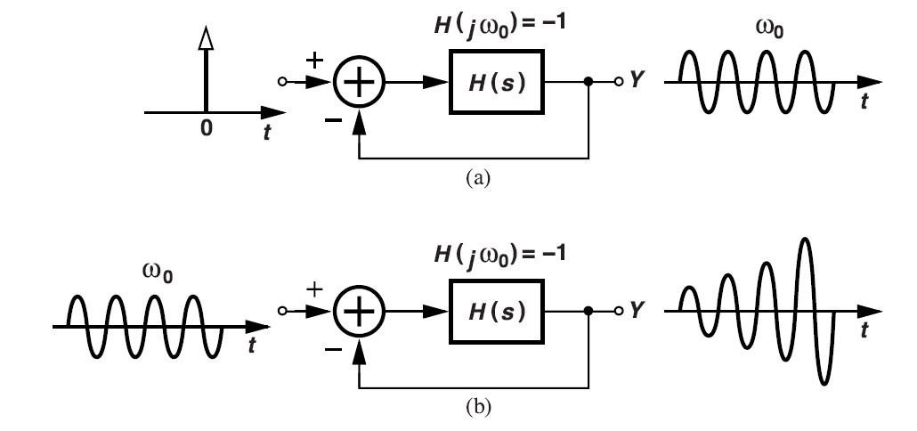
2. Oscillation Growth vs. Steady-State
Figure contrasts two cases when H(jω₀) = –1:
  (b) Continuous sinusoidal drive at ω₀: If the loop gain exceeds unity, each pass amplifies the same sinusoid, causing unbounded growth until nonlinearities clamp the amplitude.
This illustrates the difference between an oscillator at its natural condition (constant amplitude) and one driven at resonance with excess gain (growing amplitude).
  (a) Impulse response: A single “kick” yields a constant-amplitude oscillation, analogous to a perfectly lossless pendulum swinging forever.
Figure 1.8 Response of an oscillatory system to (a) an impulse, and (b) a sinusoid at ω0.

Slide 45
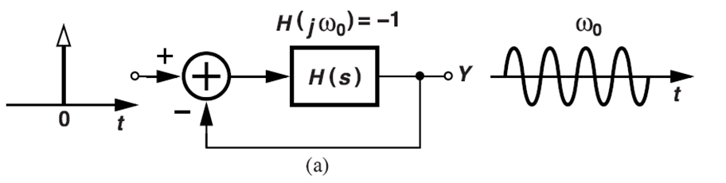
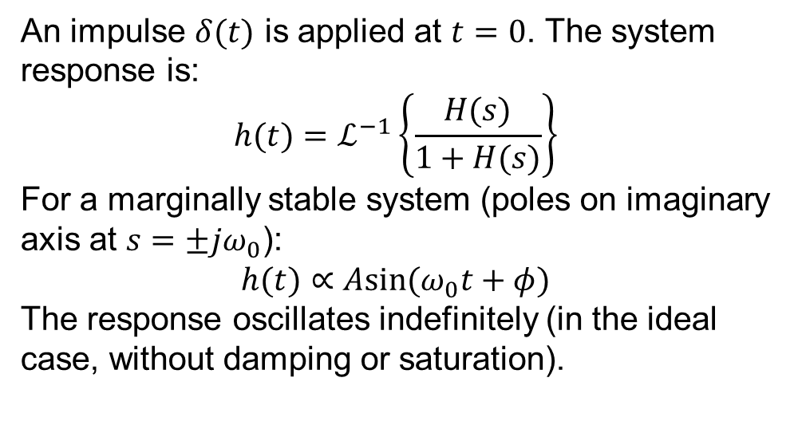
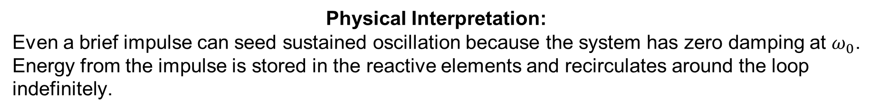
Impulse Response
An impulse $δ(t)$ is applied at $t=0$. The system response is:
$$h(t)=ℒ^{−1}\left\{\frac{H(s)}{1+H(s)}\right\}$$
For a marginally stable system (poles on imaginary axis at $s=±jω_{0}$):
$$h(t)∝Asin⁡(ω_{0}t+φ)$$
The response oscillates indefinitely (in the ideal case, without damping or saturation).
Physical Interpretation:
Even a brief impulse can seed sustained oscillation because the system has zero damping at $ω_{0}$. Energy from the impulse is stored in the reactive elements and recirculates around the loop indefinitely.

Slide 46
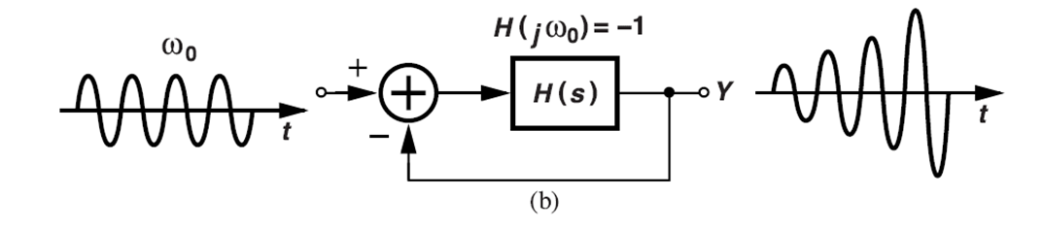
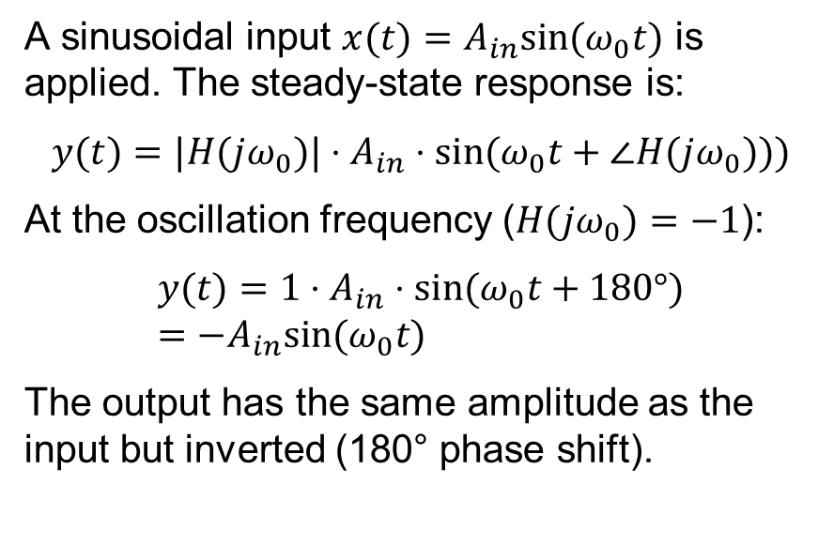
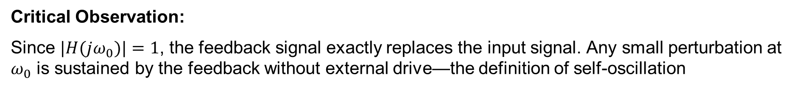
Sinusoidal Input at Oscillation Frequency
A sinusoidal input $x(t)=A_{in}sin⁡(ω_{0}t)$ is applied. The steady-state response is:
$$y(t)=|H(jω_{0})|⋅A_{in}⋅sin⁡(ω_{0}t+∠H(jω_{0})))$$
At the oscillation frequency ($H(jω_{0})=−1$):
$$y(t)=1⋅A_{in}⋅sin⁡(ω_{0}t+180°)=−A_{in}sin⁡(ω_{0}t)$$
The output has the same amplitude as the input but inverted (180° phase shift).
Critical Observation:
Since $|H(jω_{0})|=1$, the feedback signal exactly replaces the input signal. Any small perturbation at $ω_{0}$ is sustained by the feedback without external drive—the definition of self-oscillation

Slide 47
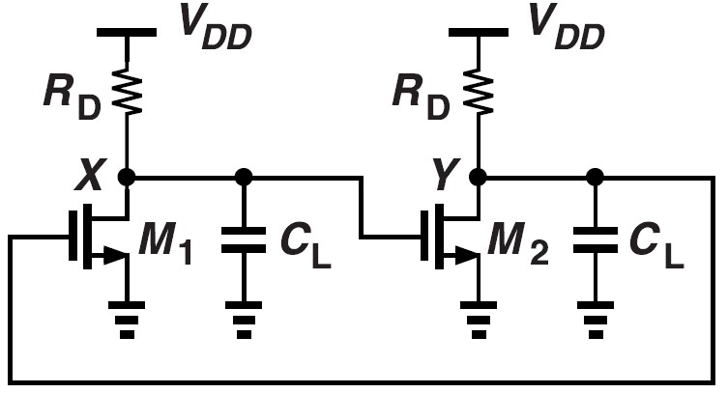
3. Positive Feedback at DC and Ring-Latch Behavior
While oscillators leverage positive feedback at a finite ω₀, unwanted positive feedback at DC must be avoided:
  Figure shows two CS stages cascaded. Each inverts, so at low frequencies the net loop gain can exceed unity and act as a static regenerative latch, not an oscillator.
  A small perturbation in V_{X} is amplified and fed back positively, forcing the outputs to rail and storing a bit of information.
V_{X}
V_{Y}
  Design Lesson: Ensure that at DC the overall loop gain remains less than unity (or negative feedback dominates) so the circuit does not latch up but only oscillates at the intended high frequency.
Figure 1.11 Two CS stages in a feedback loop.

Slide 48
4. Ring Oscillator Foundations
A ring oscillator uses a cascade of odd-numbered inverting stages (buffers or CS amplifiers) with delay elements:
  Each stage provides ~180°
  Total phase shift when the cumulative delays equal half a period.
  Loop gain >1 at that frequency ensures startup.
  Unlike LC oscillators, ring oscillators rely solely on delay-based phase shift and device gain.
This topology naturally integrates on-chip, offers wide frequency tuning via supply or device sizing, and illustrates the principle that phase timing—not energy storage in L or C alone—can define oscillation frequency.

Slide 49
Fundamental Intuition for Ring Oscillator Operation and Scaling
Designing oscillators with multiple stages (N) directly impacts
  Startup,
  Frequency,
  Gain requirements.
We will explore the fundamental, pedagogical explanation and figure breakdown tailored for in-depth lectures.

Slide 50
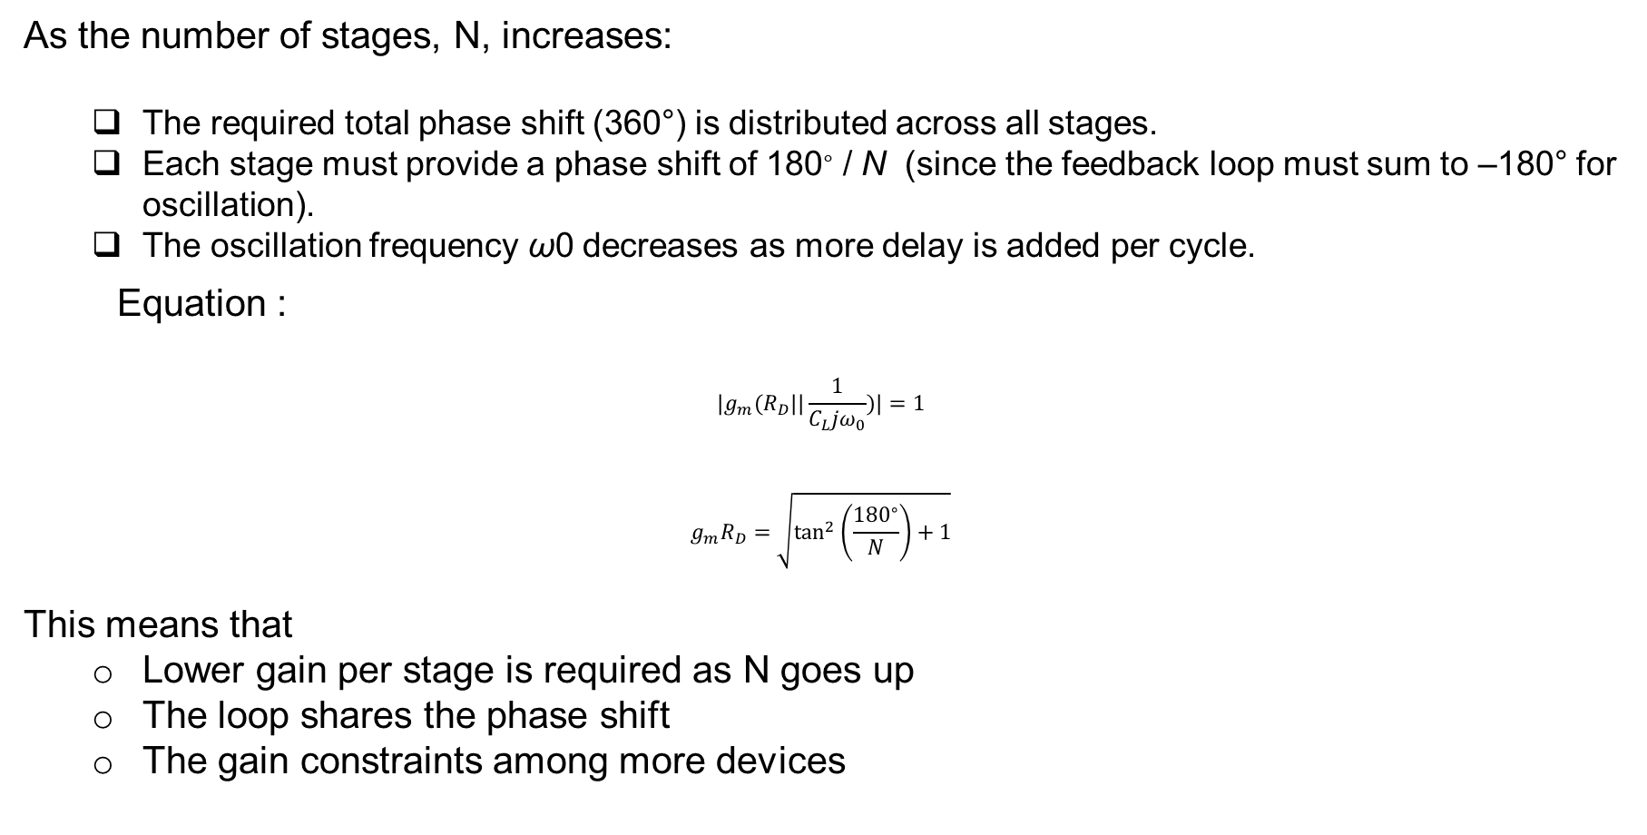
1. Ring Oscillator Phase Shift and Frequency: Scaling with N
As the number of stages, N, increases:
  The required total phase shift (360°) is distributed across all stages.
  Each stage must provide a phase shift of 180∘ / N (since the feedback loop must sum to –180° for oscillation).
  The oscillation frequency ω0 decreases as more delay is added per cycle.
Equation :
$$|g_{m}(R_{D}||\frac{1}{C_{L}jω_{0}})|=1$$
$$g_{m}R_{D}=\sqrt{\tan^{2}⁡\left(\frac{{180}^{∘}}{N}\right)+1}$$
This means that
  Lower gain per stage is required as N goes up
  The loop shares the phase shift
  The gain constraints among more devices

Slide 51


2. Three-Stage Ring Oscillator: Fundamental Operation
  Shows a three-stage common-source (CS) ring oscillator. Each stage is identical, with output capacitance CL and load resistor RD. The loop wraps output Z to input X, setting up the cyclic path.
  Shows the magnitude and phase (Bode plot) for the loop transfer function H(jω). Three cascaded amplifier stages, each contributing frequency-dependent phase shift, achieve the –180° shift at a specific frequency ω0.

Slide 52


2. Three-Stage Ring Oscillator: Fundamental Operation/ 3. Extracting Oscillation Frequency and Startup Condition
2 Loop transfer function:
$$−H(s)={\left[−g_{m}\left(R_{D}||\frac{1}{C_{L}s}\right)\right]}^{3}$$
$$H(jω)=\frac{g_{m}^{3}R_{D}^{3}}{(R_{D}C_{L}jω+1)^{3}}$$
Oscillation occurs when at this frequency:
$${\left(\frac{g_{m}R_{D}}{\sqrt{R_{D}^{2}C_{L}^{2}ω_{0}^{2}+1}}\right)}^{3}=1$$
and phase shift is –180°.
3. Equations show the interplay between gain, phase shift, and frequency:
$$ω_{0}=\frac{\sqrt{g_{m}^{2}R_{D}^{2}−1}}{R_{D}C_{L}}$$
$$\tan^{−1}⁡(R_{D}C_{L}ω_{0})={60}^{∘}$$
$$ω_{0}=\frac{\sqrt{3}}{R_{D}C_{L}}$$
$$g_{m}R_{D}=2$$
So for three stages, each stage should provide a low-frequency voltage gain of 2 at startup for robust oscillation.

Slide 53
Figure 1.12 (a) Three CS stages in a feedback loop, (b) loop transmission, and (c) node waveforms.

Slide 54

3. Extracting Oscillation Frequency and Startup Condition
Equations show the interplay between gain, phase shift, and frequency:
$$ω_{0}=\frac{\sqrt{g_{m}^{2}R_{D}^{2}−1}}{R_{D}C_{L}}$$
$$\tan^{−1}⁡(R_{D}C_{L}ω_{0})={60}^{∘}$$
$$ω_{0}=\frac{\sqrt{3}}{R_{D}C_{L}}$$
$$g_{m}R_{D}=2$$
So for three stages, each stage should provide a low-frequency voltage gain of 2 at startup for robust oscillation.

Slide 55

4. Waveform Phase Separation and Capacitance Modeling
Shows node voltages (V_{X},V_{Y},V_{Z}) through time, with a phase separation of 240°, i.e., each stage output is separated by −120∘ in phase. This aligns with the three-stage delay and is essential for multi-phase clock generation in timing circuits.
Capacitance
C_{L} at each node represents all relevant capacitances, including intrinsic node capacitance and Miller effect from transistor coupling.
Accurate modeling of C_{L} is crucial for predicting oscillation frequency, as seen in design equations.

Slide 56
5. Key Pedagogical Takeaways
Increasing N in a ring oscillator lowers the oscillation frequency and reduces the required per-stage gain at startup.
Each stage must contribute part of the total loop phase shift (split among N stages).
Oscillation is ensured when the product of gain, phase shift, and number of stages meets Barkhausen conditions.
The waveform at each node shows clear phase separation, critical for timing circuit applications.
Accurate modeling of node capacitance—including Miller effect—is essential for correct oscillator design and frequency prediction.
This progressive, energy-feedback-based view connects the mathematics to the practical design and debugging of robust ring oscillator circuits for PLLs and timing generation. Here’s a fundamental and pedagogical explanation of the ring oscillator principles and the associated figures, focusing on how increasing the number of stages (N) affects its behavior and the required gain conditions

Slide 57
Key Learning Points
Increasing stage count lowers oscillation frequency and the required per-stage gain for startup.
Phase shift divides among stages; more stages = smaller shift per stage.
Oscillation criteria are satisfied by the combined action of gain and phase through all stages.
Node voltages show predictable phase relationships, vital for applications in clocking and delay generation.
Capacitance must be carefully included in models for accurate design—especially for advanced, fast oscillators.
This foundational approach tightly links energy cycling, feedback, device modeling, and circuit design to build intuition for students and engineers working on PLLs and modern timing generators.

Slide 58
Nonlinearity, Amplitude, and Waveform Properties in Practice
Ring oscillators, inverter chains, and practical dynamic systems demonstrate how oscillator amplitude and waveform shape are determined not just by loop gain and topology, but by device nonlinearities, supply voltage, and feedback timing. Here’s a concise, fundamental conceptual guide based on the content and figures

Slide 59

1. Nonlinearity and Amplitude Stabilization
If ∣H(jω0)∣>1∣H(jω0)∣>1: Amplitude grows after startup, initiated by noise or perturbation, as shown in Figure 1.13 (VX VX building up over time from zero) .
Growth continues until the amplitude is large enough for transistor nonlinearities to reduce the effective loop gain (e.g., gm compresses as transistors enter triode/strong inversion).
The “average” loop gain falls back to unity, so amplitude self-limits at a stable value—no indefinite growth
Initial growth of VX.
Shows how a small disturbance at a node (VX) is amplified during startup, with amplitude increasing from noise until nonlinear device behavior causes gain reduction and oscillation stabilizes at a finite amplitude.

Slide 60
2. Ideal and Practical Waveform Shapes
For ring oscillators, with H(jω0)∣=1, waveforms approach pure sinusoids; with much higher gain, they resemble square waves.
Most applications desire square-ish waveforms for sharp transitions—faster switching speeds, cleaner timing edges, less noise, and improved digital compatibility.
Example: RF mixers use oscillator outputs; abrupt edges (square waves) minimize noise and maximize mixer performance.

Slide 61
3. Inverter-Based Rings: Supply Voltage Effects and Delay
Figure 1.14(a)-(d): CMOS inverter-based rings are a standard implementation—inverters replace resistive CS amplifiers.
Each inverter stage has strong gain (g_{mN}+g_{mP}), usually exceeding “2” for robust startup.
Oscillation initiates as noise amplifies through the loop until swings reach full rail-to-rail levels (VDD to ground).
Waveforms: Real node voltages (VX, VY, VZ) show propagation delay (TD)—shaped between sinusoid and square depending on gain and supply.
Voltage and Frequency Impact:
Delay of an inverter decreases with increasing supply (VDD), so oscillation frequency increases as VDD rises.
Conversely, lowering supply voltage slows the inverter, reducing ring frequency—oscillator becomes tunable against VDD.

Slide 62

(a) Three-stage inverter-based ring oscillator, (b) node waveforms, (c) realistic signal shape, and (d) waveform for a five-stage ring.
CMOS Inverter-Based Rings: Frequency and Supply Scaling
Figure 1.14 presents a CMOS-based three-stage ring oscillator, where each inverter ensures rail-to-rail voltage swings and robust startup (high small-signal gain per stage).
Node waveforms in practical rings show delay per stage (TD), important for multi-phase clock generation; with supply voltage (VDDVDD) as a tuning knob, oscillation frequency increases when VDDVDD is raised (since inverter delay drops).

Slide 63
4. Startup and Amplitude Growth
At startup (Fig. 1.13), a small disturbance (from noise) grows exponentially if loop gain exceeds unity.
Amplitude continues increasing until nonlinearity clamps the gain (transistor gmgm “rolls off” at large swings).
Equilibrium is set where average loop gain is exactly unity; output amplitude remains constant—no further growth.
Initial growth of VX.

Slide 64
5. Key Takeaways
Startup gain ∣H(jω0)∣>1 builds oscillation; nonlinearity stabilizes amplitude.
Ideal waveforms are application-driven: square for digital, moderate for RF.
CMOS inverter delays are supply dependent; higher VDD boosts frequency.
Amplitude growth and stabilization are dictated by interplay of gain and device physics.
This fundamental view links oscillation growth, nonlinear steady-state behavior, waveform shaping, and design sensitivity to supply voltage—which are core to robust ring oscillator and PLL system design. Here’s a concise, fundamentally intuitive explanation for lecture purposes, including figure highlights:

Slide 65
Nonlinearity and Oscillation Amplitude
In practical ring oscillators, once the initial noise or perturbation grows into an oscillation, further amplitude increase is limited by device nonlinearities—the circuit “self-limits” because large signal swings lower stage gain, eventually bringing the loop gain to unity.
Thus, the amplitude of oscillation is well-defined in practice and typically approaches rail-to-rail for CMOS rings, even though amplitude calculation is complex in nonlinear conditions.

Slide 66
Design Insights
Startup: Begin with loop gain > 1 for regeneration; amplitude is clamped by device nonlinearity.
Waveform tailoring: Design for square wave shapes if sharp, low-noise transitions are needed; this is typical in digital/RF systems.
Voltage/frequency scaling: Supply voltage is a convenient knob for tuning oscillation frequency in inverter-based rings.
Amplitude settling: “Average” loop gain falls to unity as devices saturate; stable swings are assured if designed for proper low-frequency gain.
This foundational view bridges startup physics, amplitude control, waveform shaping, and supply-dependent frequency—all critical for robust ring oscillator and PLL design.Here’s a fundamental, intuitive guide to these ring oscillator concepts, ideal for lectures with clear figure highlights:

Slide 67
Fundamental Takeaways
Nonlinearity ensures practical oscillators have stable voltage amplitude—no runaway growth.
Abrupt, square-like transitions are preferred for low noise and fast circuit response.
Frequency can be tuned using supply voltage in inverter-based designs—an essential PLL and clock generator strategy.
Oscillation amplitude, waveform shape, and frequency all arise from the same interplay: device physics, feedback, and gain.
These insights connect oscillator startup, amplitude settling, waveform design, and supply-dependent frequency scaling, giving students a holistic view of ring oscillator fundamentals and practical design

Slide 68
Fundamental Understanding of Lossy LC Tanks and Oscillator Resonance
The content delves into realistic LC oscillator modeling, where ideal elements are replaced with lossy inductors and equivalent parallel resistance to better capture physical behavior and performance limits. Here's an intuitive breakdown and figure explanations optimized for lectures.

Slide 69


1. Basic LC Tank Behavior
Ideal Components
Capacitor $C$ modeled as $I=C\frac{dV}{dt}$
Inductor $L$ modeled as $V=L\frac{dI}{dt}$
When combined in parallel, the impedance behaves inductively at low frequencies and capacitively at high frequencies, crossing zero reactance at the resonant frequency $ω_{0}=\frac{1}{\sqrt{L_{1}C_{1}}}$.
Figure 1.15 (a,b)
(a) Ideal parallel LC tank circuit.
(b) Impedance magnitude peaks sharply at resonance (ω₀) and shows corresponding phase shift from +90° (inductive) to –90° (capacitive) behavior.
Figure 1.15 (a) Ideal parallel LC tank, and (b) its impedance characteristics.

Slide 70

2. Realistic Losses in the LC Tank
Series Resistance R_{S} (Fig. 1.16(a))
  Inductors have parasitic resistance due to wire loss—this dissipates energy, detracting from ideal oscillation.
  This energy loss lowers quality factor (Q), broadens resonance, and increases phase noise.
Equivalent Parallel Model (Fig. 1.16(b))
  To simplify analysis, losses are represented as a parallel equivalent resistance Rp.
  This allows easier calculation of tank impedance at resonance and quality factor.
Figure 1.16 (a) Lossy LC tank, and (b) its equivalent model.

Slide 71


3. Relationship Between L_{p}, R_{p}, and L₁, R_{S}
Step 1: Series R-L Tank Impedance
The inductor with series resistance $R_{S}$ and inductance $L_{1}$ has a complex impedance at angular frequency $ω$:
$$Z_{series}=R_{S}+jωL_{1}$$
Step 2: Equivalent Parallel Model
This series combination is often represented equivalently by a parallel tank with parameters $L_{p}$ and $R_{p}$, having impedance:
$$Z_{parallel}=\frac{jωL_{p}R_{p}}{R_{p}+jωL_{p}}$$
We want to find $L_{p}$ and $R_{p}$ such that at a given $ω$, the impedances match:
$$Z_{series}=Z_{parallel}$$

Slide 72


Cont..
Step 3: Equate Real and Imaginary Parts
Writing $Z_{parallel}$ in terms of real and imaginary parts gives:
$$Z_{parallel}=\frac{jωL_{p}R_{p}(R_{p}−jωL_{p})}{R_{p}^{2}+(ωL_{p})^{2}}=\frac{jωL_{p}R_{p}R_{p}−j^{2}ω^{2}L_{p}^{2}R_{p}}{R_{p}^{2}+(ωL_{p})^{2}}$$
Simplifying with $j^{2}=−1$:
$$Z_{parallel}=\frac{jωL_{p}R_{p}^{2}+ω^{2}L_{p}^{2}R_{p}}{R_{p}^{2}+(ωL_{p})^{2}}=R_{e}+jX_{e}$$
where real part:
$$R_{e}=\frac{ω^{2}L_{p}^{2}R_{p}}{R_{p}^{2}+(ωL_{p})^{2}}$$
and imaginary part:
$$X_{e}=\frac{ωL_{p}R_{p}^{2}}{R_{p}^{2}+(ωL_{p})^{2}}$$
Step 4: Set Equal to Series Parts
Equate to series parts:
$$R_{S}=R_{e}=\frac{ω^{2}L_{p}^{2}R_{p}}{R_{p}^{2}+(ωL_{p})^{2}} ωL_{1}=X_{e}=\frac{ωL_{p}R_{p}^{2}}{R_{p}^{2}+(ωL_{p})^{2}}$$
Dividing the imaginary by real gives:
$$\frac{ωL_{1}}{R_{S}}=\frac{X_{e}}{R_{e}}=\frac{ωL_{p}R_{p}^{2}}{ω^{2}L_{p}^{2}R_{p}}=\frac{R_{p}}{ωL_{p}}$$
Rearranged:
$$R_{p}=ω^{2}L_{1}L_{p}/R_{S}$$
Step 5: Approximate $L_{p}≈L_{1}$
Since inductance values are close, set $L_{p}≈L_{1}$. Then:
$$R_{p}≈\frac{ω^{2}L_{1}^{2}}{R_{S}}$$

Slide 73

Interpretation:
Smaller series resistance $R_{S}$ means larger equivalent parallel resistance $R_{p}$, indicating less loss and better tank quality.
The parallel inductance $L_{p}$ remains approximately equal to the actual inductance $L_{1}$.
Physical Significance:
This conversion helps simplify circuit analysis by modeling the physical lossy inductor as an ideal inductance $L_{p}$ in parallel with a loss resistance $R_{p}$, making it easier to predict oscillator Q-factor and behavior at resonance.

Slide 74

Frequency Dependence and Approximations in Lossy LC Tanks
Understanding how frequency affects the equivalent parallel resistance $R_{p}$ and inductance $L_{p}$ of a lossy LC tank is critical for accurate oscillator design, especially at high frequencies.
1. Breakdown of Approximation at Low Frequencies
The commonly used approximation:
$$\frac{R_{S}^{2}}{L_{1}^{2}ω^{2}}≪1$$
assumes the series resistance $R_{S}$ squared over $L_{1}^{2}ω^{2}$ is much less than 1. This lets us write:
  $L_{p}≈L_{1}$
  $R_{p}≈\frac{L_{1}^{2}ω^{2}}{R_{S}}$
Why it breaks down: At low frequencies, $ω$ is small, so $\frac{R_{S}^{2}}{L_{1}^{2}ω^{2}}$ can be significant or larger than 1, violating the approximation. As a result, the calculated $R_{p}$ becomes inaccurate, potentially underestimating losses.
This means:
  At low frequencies, the simple formulas overpredict tank quality.
  Oscillator parameters derived from these may be unreliable.

Slide 75

Cont..
2. Exact Frequency-Dependent Model for $R_{p}$
Equation 1.36 in the source text gives a precise expression for $R_{p}$ that includes frequency effects:
$$R_{p}=f(ω,L_{1},R_{S}) \text{(}\text{exact} \text{formula} \text{including} \text{frequency} \text{dependency}\text{)}$$
This formula captures how $R_{p}$ varies with frequency beyond the approximation.
In practical terms:
At higher frequencies, effective $R_{p}$ increases compared to low frequency, implying lower losses at resonance.
Accurate plotting of $R_{p}$ over frequency is vital for high-frequency oscillator design to predict phase noise and stability.

Slide 76


Example Quantifying Approximation Error
The document’s Example 1.9 shows:
When assuming a constant $R_{p}$ value based on low frequency,
At $5.5 \text{GHz}$ the error was about 18%.
This is a substantial deviation, emphasizing that for GHz-range oscillators, frequency-dependent losses must be modeled carefully to avoid underestimating tank losses and degrading oscillator performance prediction.

Slide 77

4. Visualizing the Losy Parallel LC Tank
Figure 1.17 (a) Parallel lossy LC tank, (b) magnitude of impedance, and (c) phase of impedance .
(a) Circuit: Shows realistic tank with L₁, C₁, and parallel equivalent loss resistance R_{p} representing inductor series loss transformed into parallel form.
(b) Magnitude plot: Impedance magnitude peaks sharply at resonance with finite R_{p}. The peak height relates to tank quality; a finite R_{p} lowers and broadens the peak compared to ideal tank.
(c) Phase plot: Exhibits phase angle moving from +90° (inductive dominance at low frequency) through 0° at resonance to –90° (capacitive dominance at high frequency). The sharpness of the phase transition reflects the losses; lower losses create sharper phase transitions.

Slide 78
Summary for Teaching
Approximate tank loss models are useful but can significantly err at low frequencies or where RS and ω interplay.
Exact frequency-dependent expressions for Rp improve oscillator loss and Q-factor predictions, crucial at GHz frequencies.
Graphical plots (Fig 1.17) clearly show how losses affect impedance magnitude and phase, aiding intuitive understanding.
Conceptual takeaway: Frequency-dependent losses affect oscillator purity, jitter, and sustainable oscillation amplitude — crucial for high-performance PLL design. Modeling these precisely enables better design trade-offs

Slide 79

Example Calculation: Frequency-Dependent $R_{p}$ of a Lossy Inductor Tank
Given:
  Inductance: $L_{1}=5 \text{nH}$
  Series resistance: $R_{S}=20 Ω$
  Resonance is near $5 \text{GHz}$ (angular frequency $ω_{0}=2π×5×{10}^{9}$)
Step 1: Calculate $R_{p}$ using the approximate low-frequency formula
$$R_{p}≈\frac{L_{1}^{2}ω_{0}^{2}}{R_{S}}$$
Calculate:
$L_{1}^{2}=(5×{10}^{−9})^{2}=25×{10}^{−18}$
$ω_{0}^{2}=(2π×5×{10}^{9})^{2}≈(3.14×{10}^{10})^{2}=9.87×{10}^{20}$
So,
$$R_{p}≈\frac{25×{10}^{−18}×9.87×{10}^{20}}{20}=\frac{2467.5}{20}=123.375 Ω$$

Slide 80

Step 2: Calculate exact $R_{p}$ accounting frequency dependence:
$$R_{p}=R_{S}+\frac{L_{1}^{2}ω_{0}^{2}}{R_{S}}$$
Here,
$$R_{p}=20+123.375=143.375 Ω$$
Step 3: Evaluate approximation error
Using approximate $R_{p}=123.375 Ω$, the error relative to exact is:
$$\frac{|143.375−123.375|}{143.375}×100\%≈14\%$$
This illustrates that ignoring the $R_{S}$ term induces a sizeable underestimate in parallel loss resistance, which can mislead the designer about achievable tank Q-factor and oscillator performance at high frequency.

Slide 81


Visual Aid Explanation
(a) Parallel lossy LC tank with $L_{1},C_{1},R_{p}$
  Realistic tank model replaces purely inductive losses with the parallel resistor $R_{p}$, easing AC circuit analysis.
(b) Impedance magnitude vs. frequency
  Peak impedance at resonance relates directly to $R_{p}$ (loss).
  Larger $R_{p}$ → higher peaks & sharper resonance → better oscillator phase noise and stability.
(c) Phase plot
  Phase transition from +90° (inductive) to –90° (capacitive)
  Losses smooth & broaden this phase transition; more loss → gentler slope and degraded oscillator purity.

Slide 82

Summary
At high frequencies, the term $L_{1}^{2}ω_{0}^{2}/R_{S}$ dominates parallel resistance.
At lower frequencies, the series resistance $R_{S}$ adds directly to $R_{p}$, increasing total loss.
Ignoring frequency dependence in $R_{p}$ can lead to underestimating tank losses by >10%.
Precise loss modeling is crucial for accurate oscillator Q prediction and design optimization.
Graphical impedance magnitude and phase plots vividly demonstrate how loss affects resonant behavior and oscillator signal quality.

Slide 83

Sharper Resonance and Phase from Higher R_{p}
Core Principle: Loss and Resonance Sharpness
The parallel RLC tank models energy loss via a parallel R_{p}.
At resonance (ω₀), impedance peaks at R_{p}; larger R_{p} means less energy loss and higher quality factor (Q).

Slide 84



Doubling R_{p}
Suppose:
R_{p} doubles
L₁ and C₁ remain constant
Find:
What happens to the phase slope and profile in Fig.?
Analytical Details
The tank impedance with parallel loss is:
$$Z_{1}(s)=(L_{1}s)∥\left(\frac{1}{C_{1}s}\right)∥R_{p}$$
which reduces to:
$$Z_{1}(s)=\frac{R_{p}L_{1}s}{L_{1}C_{1}R_{p}s^{2}+L_{1}s+R_{p}}$$
For s = $jω$:
$$Z_{1}(jω)=\frac{jR_{p}L_{1}ω}{R_{p}(1−L_{1}C_{1}ω^{2})+jL_{1}ω}$$
Phase Response Calculation
$$∠Z_{1}(jω)=\frac{π}{2}−\tan^{−1}⁡\left(\frac{L_{1}ω}{R_{p}(1−L_{1}C_{1}ω^{2})}\right)$$
The larger R_{p} $,the steeper the phase transition near$
$resonance($ω₀).
Around resonance, differentiating gives:
$${\left.\frac{d}{dω}∠Z_{1}(jω)\right|}_{ω_{0}}≈−2R_{p}C_{1}$$
Slope is linearly proportional to $R_{p}$: doubling $R_{p}$ makes the phase transition twice as steep

Slide 85

Visual Intuition From Figure 1.17
Impedance plot (Fig. 1.17b): Peak at resonance is higher and narrower for larger Rp.
Phase plot (Fig. 1.17c): The transition from +90° to –90° is more abrupt—a "sharper knee" at resonance for higher Rp.
  This means the circuit discriminates frequency more precisely, i.e., better filtering and less phase noise.
Practical Importance
High Q-tanks (large Rp): narrow bandwidth, sharply defined resonance, critical for low-phase-noise oscillators and sensitive frequency-selective circuits.
Low Q-tanks (small Rp): broad resonance, less frequency discrimination, more loss, higher phase noise.
Real-World Note: If inductor loss is modeled as series RSRS, phase stays near zero at DC, but practical impact is small for most oscillator design uses.

Slide 86
Teaching Takeaway
A larger parallel resistance in the LC tank sharpens both resonance (impedance peak) and phase transition, making oscillators more spectrally pure.
The slope of phase at resonance is proportional to Rp; doubling Rp doubles sharpness.
Use phase and impedance plots to explain how Q and loss shape oscillator stability and selectivity.
This links the physical component choice (high-Q inductors/capacitors, low-loss PCB routing) to clear circuit metrics and graphical behavior, ideal for illustrating advanced oscillator design fundamentals.Here is a detailed, pedagogically focused explanation of the loss effect and phase slope in LC tanks, directly building on the equations and figures in your textbook.

Slide 87

Practical Significance
High-Q (large Rp) tanks discriminate frequency well, reduce close-in phase noise, and are desirable for precise oscillators.
Low-Q (small Rp) tanks have broader, less defined resonance, leading to increased loss and degradation of oscillator purity

Slide 88

Quality Factor Q Fundamentals
$Q$ quantifies how “good” an inductor or resonator is; higher $Q$ means lower loss and sharper resonance.
For an inductor $L_{1}$ with series resistance $R_{S}$:
$$Q=\frac{L_{1}ω}{R_{S}}$$
Alternatively, from equivalent parallel resistance $R_{p}$ and inductance $L_{1}$:
$$Q=\frac{R_{p}}{L_{1}ω}$$
Thus $R_{p}$ should be large for a high-Q and better oscillator tank.
$Q$ can also be viewed as proportional to the phase slope of the tank impedance at resonance:
$$Q=\frac{ω_{0}}{2}\left|\frac{d}{dω}∠Z_{1}(jω)\right|$$

Slide 89


Amplifier with Tuned Load
(a) Shows a common-source (CS) stage loaded by a parallel lossy LC tank $L_{1},C_{1},R_{p}$.
(b) Equivalent circuit at resonance, simplifying to an effective voltage gain proportional to $g_{m}R_{p}$.
(c) Frequency response highlights sharp gain peak at $ω_{0}$ and 180° phase shift.
This tank behaves like a band-pass filter (BPF), enhancing amplification near resonance and suppressing off-resonance signals.
Figure 1.18 (a) CS stage using a tuned load, (b) equivalent circuit at
resonance, and (c) frequency response.

Slide 90
Explaining Q Factor for Ring Oscillators — Fundamental, Intuitive Approach
The Quality Factor (Q) measures how effectively an oscillator stores energy compared to how much energy it loses each cycle. Higher Q means lower energy loss and more stable, pure oscillations
What is Q Factor?
Q factor = (Energy stored) / (Energy lost per cycle), or equivalently, how many oscillation cycles happen before the energy decays significantly.
Higher Q → oscillations die out slowly if not sustained; Lower Q → faster decay.
Q Factor in Ring Oscillators
In a ring oscillator, energy is not stored in a traditional reactive tank (LC) but is instead maintained through delay and gain in cascaded inverter stages.
Q is generally low (3–10 range) because of intrinsic device losses, switching losses, and lack of real energy storage.
This means:
  Oscillations have relatively broad frequency spectrum (less selective).
  More phase noise compared to LC oscillators.
  But it is simple, compact, and easily tuned by supply voltage or transistor sizing.

Slide 91
Measuring and Visualizing Q: The Ring-Down Method
Imagine briefly exciting the oscillator and then measuring how many cycles it takes for the oscillation amplitude to drop by half.
The number of cycles to halve amplitude multiplied by ~4.5 approximates Q.
Ring oscillators show a fast decay in amplitude without sustaining energy in reactive components, confirming their low Q.
Aspect | Ring Oscillator | LC Oscillator
Energy Storage | No true reactive tank, relies on delay | Real energy storage in inductor & capacitor
Typical Q | Low (~3-10), limited by device/switch losses | High (100 or more), limited mainly by inductor losses
Frequency Stability | Moderate, easier to tune via supply | High, very stable frequency
Phase Noise | Relatively high phase noise | Lower phase noise, clean signals
Integration Ease | High — all CMOS, compact | Requires inductors, usually larger area

Slide 92
Intuitive Summary
Think of Q as "how long the oscillator can keep ringing on its own."
Ring oscillators "ring" less efficiently — their energy quickly slips away, so they have a low Q.
LC oscillators hold energy in physical inductors and capacitors — their "ringing" persists longer with sharper frequency definition — they have high Q.
Ring oscillators trade quality for simplicity and integration, while LC oscillators favor signal purity and stability.

Slide 93
Quality Factor and Oscillator Types: Ring vs LC
Characteristic | Ring Oscillator | LC Oscillator
Energy Storage Mechanism | Uses delay and inverter stages | Real energy storage with discrete L and C
Typical Q | Low (around 3-10), limited by device losses and delay | High (often >100), limited mainly by inductor loss
Frequency Control | Easily tunable via supply voltage or device sizing | Frequency set by tank L and C values, more stable
Phase Noise | Higher—lower Q implies more noise | Lower—higher Q means better spectral purity
Waveform | Square-like due to digital transitions | Sinusoidal and smooth
Integration | Compact and fully CMOS compatible | Larger area due to inductors, more precious

Slide 94
Pedagogical Conclusion
Ring oscillators have lower Q due to no real energy storage, affecting phase noise and stability, but excel in tunability and integration.
LC oscillators provide high-Q resonance with superior phase noise performance, favored in precision timing applications.
Understanding Q in both contexts helps students appreciate tradeoffs in oscillator design—compactness vs performance and tunability vs spectral purity.
These insights build student intuition on oscillator device choice and performance expectations for phase-locked loops and clock generation systems.

Slide 95

Cont..
If desired, can design graphics or tables summarizing this comparison visually.Quality Factor $Q$ measures how good an inductor or resonator is, quantifying sharpness of resonance and losses. For an inductor $L_{1}$ with series resistance $R_{S}$,
$$Q=\frac{L_{1}ω}{R_{S}}$$
Alternatively, using the parallel tank representation with resistance $R_{p}$,
$$Q=\frac{R_{p}}{L_{1}ω}$$
where larger $R_{p}$ means higher $Q$ and better tank performance. $Q$ can also be seen as proportional to the slope of the phase response near resonance,
$$Q=\frac{ω_{0}}{2}\left|\frac{d}{dω}∠Z_{1}(jω)\right|$$
Figure 1.18 shows a common-source stage loaded with a parallel LC tank acting as a bandpass filter with sharp voltage gain peak at $ω_{0}$.

Slide 96
Comparison: Ring Oscillator vs LC Oscillator Quality Factor
Aspect | Ring Oscillator | LC Oscillator
Energy Storage | Uses delay and inverter phases | Uses real L-C energy storage
Typical Q | Low (3–10), limited by device delays and losses | High (often >100), limited by inductor losses
Frequency Control | Tunable via supply voltage and device sizing | Fixed by LC values; more stable
Phase Noise | Higher phase noise (lower Q) | Lower phase noise (higher Q)
Waveform Shape | Square-like edges | More sinusoidal
Integration | Compact, CMOS friendly | Requires high-quality inductors, larger chip area
Ring oscillators trade spectral purity for tunability and compactness, while LC oscillators offer superior phase noise and frequency stability for precision PLL applications.
This conceptual framework guides oscillator design decisions balancing Q, integration, tuning, and noise.

Slide 97
Intuitive Takeaways
High Q matters because it determines how “sharp” the resonant frequency is, impacting phase noise and oscillator stability.
Ring oscillators trade low Q for tunability and integration ease—ideal for many CMOS timing applications where integration and low cost dominate.
LC oscillators offer high Q for best spectral purity and low phase noise, commonly used in RF and precision PLL synthesis.
Understanding and calculating Q helps designers balance these tradeoffs for desired oscillator performance.

Slide 98
LC Oscillators as Feedback Systems
Core Concept:
LC oscillators use amplifier stages with LC tanks, arranged in a feedback loop.
Oscillation occurs if the total loop phase shift is 360° and loop gain is high enough.
Typical cross-coupled setup: Two identical common-source stages, each with its own LC tank.
Takeaway:
The combination of high-Q tanks, cross-coupled feedback, and amplifier gain is the foundation for reliable, stable sinusoidal oscillation at resonance frequency

Slide 99
Analysis of Latch-Up in LC Oscillators
Concept:
Latch-up means the oscillator gets stuck at a DC level rather than oscillating.
At low frequencies (near DC), the parallel tank model breaks down.
If inductor resistance R_{S} is not negligible, the DC loop acts as two resistors and devices in a feedback loop.
Takeaway:
Latch-up is avoided if (g_{m}R_{S})²<1, ensuring the loop gain at DC is less than unity. Most practical designs meet this easily.

Slide 100


Circuit Topologies and Redrawn Forms Figures:
  Fig. 1.20(a): Two cascaded CS stages with LC tank loads showing feedback path.
  Fig. 1.20(b): The same oscillator, redrawn as a symmetric cross-coupled pair—a standard for integrated designs.
  Fig. 1.21: Shows the low-frequency (DC) equivalent where the tanks reduce to resistors.
Takeaway:
The cross-coupled representation highlights differential operation and startup conditions, with X and Y nodes swinging differentially.
Figure 1.20 (a) Two cascaded tuned CS stages in a loop, and (b) the circuit redrawn
as cross-coupled amplifiers.
Figure 1.21 LC oscillator equivalent circuit at low frequencies.

Slide 101

Oscillator Waveforms and Operation
Concept:
  As the loop gain is set above unity, the circuit ensures large voltage swings.
  M₁ and M₂ alternately turn on and off, switching drain currents between zero and maximum.
  The parallel tanks filter the square-like current waveforms into clean, sinusoidal voltages at each node.
Figure 1.22:
  I_{D1}, I_{D2}: Pulsed drain currents.
  V_{X}, V_{Y} : Out-of-phase, sinusoidal voltage waveforms due to LC filtering.
Takeaway:
  Despite pulsed device currents, parallel tanks ensure sinusoidal voltage—even-order harmonics are filtered out, yielding a pure output.
Figure 1.22 Cross-coupled oscillator waveforms.

Slide 102

Figure 1.22 Cross-coupled oscillator waveforms.

Slide 103
Key Performance and Design Considerations
Fundamental Points:
  Common-mode output voltage ≈ V_{DD}.
  Voltage at each node is sinusoidal; current is not.
  The oscillator’s ability to filter harmonics and produce clean waveforms is what makes LC-based designs critical for RF and clock circuits.
  Maximum V_{DS} seen by transistors is V_{DD}+V_{p}, which may set constraints in process choice and reliability.
Takeaway:
Understand and balance tank Q, loop gain, and device stress—all are essential for a robust, high-performance LC oscillator.

Slide 104

Figure 1.23 (a) Small-signal model of oscillator, (b) model with merged tanks, and (c) equivalent circuit for calculating output resistance of cross-coupled pair.
Oscillation Test Using Differential Impedance
Concept:
To check if an LC oscillator will oscillate, measure the impedance between the two tank nodes (X and Y).
If the impedance goes to infinity at some frequency, oscillation is possible.
Fundamental Takeaway:
Testing for infinite impedance between nodes reveals if the circuit supports sustained oscillation.

Slide 105
Small-Signal Model and Merged Tank
Concept:
For differential nodes X and Y, combine both tanks as shown in Fig. 1.23(b):
  Inductance doubles: 2L
  Capacitance and resistance halves: 2C, 2Rp
Redraws the circuit as a single tank between X and Y for easier analysis and impedance calculation.
Fundamental Takeaway:
Merging tanks into a single equivalent tank simplifies the math without changing the physics for differential analysis.

Slide 106
Output Resistance of the Cross-Coupled Pair
Concept:
  The cross-coupled transistors provide a negative resistance between X and Y.
  By KVL and inspection, this resistance is −2/gm.
Figure Integration:
Fig. 1.23(c): The tank is in parallel with the negative resistance provided by M1,M2.
Fundamental Takeaway:
Cross-coupled pairs convert their gain into negative resistance, essential for overcoming tank losses and starting oscillations

Slide 107

Oscillation Condition & Mathematical Test
Concept:
Oscillation occurs if the parallel combination of:
The tank impedance (at resonance, very high)
The negative resistance (at the right gm)
goes to infinity — this means the circuit supports undamped oscillations.
At resonance:
This leads directly to the startup condition: gmRp=1.
Fundamental Takeaway:
The circuit oscillates if the negative resistance cancels the tank’s loss, exactly matching at startup.

Slide 108

Intuitive & Rigorous Perspective
Concept:
The exact math (Eq. 1.48) confirms oscillation at when gmRp=1, same as impedance test.
The cross-coupled pair’s negative resistance is mathematically just as valid and crucial in complex analysis as it is intuitively.
Fundamental Takeaway:
Both intuitive circuit analysis and rigorous impedance calculations point to the same requirement: negative resistance = tank loss for startup. Cross-coupled LC oscillators embody this physical principle beautifully.

Slide 109

Differential Pair with LC Loads
Essentials: Two transistors (M1, M2) form a differential pair. Each drain is loaded with a parallel LC tank (L, C, Rp) and biased with tail current ISS.
Core Idea:
The tail current splits between the two devices according to the input, and the LC tanks set the frequency selectivity and shape the output waveform at nodes X and Y.
Key Point:
This arrangement provides differential outputs, meaning VX and VY always move in opposite directions
Gain/Phase Response
Gain Response:
Shows a sharp gain peak at ω0, characteristic of resonance—thanks to high-Q tanks, output voltage is maximum at the resonance frequency.
Phase Response:
The phase transitions rapidly near ω0, another sign of the strong filtering of the tank.
Intuitive Takeaway:
The parallel tank acts like a narrow bandpass filter, allowing oscillations only at ω0.

Slide 110

Input/Output Currents and Voltages
Current Waveforms (ID1, ID2):
With a large signal, each drain current switches sharply between 0 and ISS, much like a square wave.
Voltage Waveforms (VX, VY):
Despite the abrupt currents, the LC filtering at each node transforms these into smooth, nearly sinusoidal voltages, with a phase difference of 180°.
Intuitive Takeaway:
The LC tanks “sculpt” the square current waves into clean sine waves, suppressing harmonics.

Slide 111

Frequency Components in Square Wave
Boxed Harmonic Content:
Magnifies the key point that a square wave toggling between +1 and –1 contains a fundamental at 4/π amplitude.
Intuitive Use:
The amplitude of the voltage swing from the square-like current is understood via the fundamental harmonic—explaining why the output swing is (2/π)ISS Rp for each side, and 8/π ISS Rp peak-to-peak differential.

Slide 112

Differential Pair with Negative Feedback
Description:
Shows a configuration where feedback opposes the motion—phase shift around loop totals 360°, but doesn't produce sustained oscillations.
Takeaway:
Not all feedback arrangements in this topology will result in oscillation!

Slide 113

Differential Pair with Positive Feedback (Cross-Coupled)
Description:
Feedback lines are swapped, introducing extra 180° phase shift and providing a total of 0° (or multiples of 360°), fulfilling Barkhausen's criterion.
Key Point:
This “cross-coupled” form (with M1 and M2 feeding opposite gates) is the classic architecture for robust, startup-guaranteed LC oscillators.
Cross-Coupled Pair Schematic
Simplified Schematic:
Presents the most common modern implementation. This setup nearly always oscillates as long as gm Rp ≥ 1 and biasing is correct.
Intuitive Takeaway:
Cross-coupled LC oscillators are “fool-proof” because their symmetry, feedback, and operating point guarantee both reliable startup and large output swing

Slide 114
Overall Takeaways
The LC tanks filter abrupt switching into sinusoidal voltages: square current in, sine voltage out.
Output swing is maximized not by device size, but by bias current and tank resistance, with simple relationships based on waveform harmonics.
Proper feedback is essential—cross-coupling creates the necessary phase for startup and clean oscillation.
These topologies balance biasing, symmetry, Q, and feedback to deliver the robust oscillators found in every serious PLL or RF system.

Slide 115

Lossless LC Tank—Natural Oscillation
Concept: Shows a basic LC oscillator with a charged capacitor (C1) and an inductor (L1), no losses.
Process:
  Initially, all energy is in the capacitor as electric energy (V0 across C1).
  As the circuit is released, this energy converts to magnetic form in L1, making current flow.
  The process reverses cyclically, swapping energy between C and L, causing sinusoidal voltage oscillation (Vout).
Key Insight:
In a perfect LC (no loss), this oscillation would continue forever. The voltage alternates smoothly, just like an undamped pendulum swinging back and forth
(a) Response of a lossless LC tank to an initial condition,

Slide 116

Lossy LC Tank—Oscillation Decay
Concept: Adds a resistor (Rp) in parallel with the LC tank to model energy loss.
Process:
  Some energy is now dissipated as heat each cycle.
  The amplitude of the oscillation (Vout) decreases with time (exponential decay).
Key Insight:
Like a pendulum slowed by air resistance, real LC tanks lose energy. Once released, oscillations will slowly die away unless energy is “tapped in” externally.
Response of a lossy LC tank,

Slide 117

Tapping the Tank—Sustained Oscillation with Negative Resistance
Concept: Shows the addition of a negative resistance (−Rp) in parallel to the tank.
Process:
  This negative resistance exactly cancels out the tank loss (Rp), so the circuit becomes lossless.
  The oscillation in Vout now remains steady (constant amplitude)—no more decay.
Key Insight:
Negative resistance is a “mathematical tap” that replenishes lost energy each cycle. In practical LC oscillators, an active circuit (like a cross-coupled transistor pair) supplies this negative resistance, allowing continuous, undamped oscillation.
Use of a negative resistance to sustain oscillation.

Slide 118

Circuit Exhibiting Negative Resistance
Concept:
A MOS transistor (M1) and two capacitors (C1, C2) arranged so current between X and Y can flow either direction. No DC ground for the source.
Fundamental Insight:
This structure can provide a negative resistance between X and Y (as the small-signal current flows “backward” to compensate losses in a resonator).
Key Point:
Negative resistance allows the circuit to actively offset tank losses, making continuous oscillation possible just like the cross-coupled pair—but through a different topology
Circuit exhibiting negative resistance.

Slide 119

Basic Three-Point Oscillator
Concept:
Shows a tank with inductor (L1), two capacitors (C1,C2), and one MOS transistor across the tank.
Key Step:
This “three-point” configuration (“Hartley” or “Colpitts” oscillators, depending on node connected to ground) uses transformer-like feedback for oscillation.
Physical Explanation:
The combination of C1 and C2 divides tank voltage and provides the necessary phase shift between gate and source/drain, enabling negative resistance to appear at the critical point.

Slide 120

Equivalent Loss Model
Insight:
Loss in L1 is modeled as series RS, and the active device provides negative resistance in parallel.
Startup Condition:
Oscillation starts if the negative resistance magnitude is at least as large as the equivalent tank loss, which in this topology depends on the ratio and the tank Q.

Slide 121

Three Practical Oscillator Realizations
(a): Basic three-point with source grounded (often “Hartley” or “Colpitts”).
(b): Adds a bias tail current for better stability and practical operation.
(c): Swaps which node is grounded—the “Colpitts oscillator” is a classic.
Key Intuition:
Each of these is a special case of providing feedback with precise phase and gain; a negative resistance is synthesized at the active device’s terminals to cancel tank loss.
Oscillators derived from the three-point topology.

Slide 122


Key Formula Connections
Design Takeaway:
For a given Q, this “three-point” oscillator requires more transconductance than the cross-coupled oscillator (minimum gmRp=4 for C1=C2).
The Colpitts and Hartley are robust but need careful component scaling.
Conceptual Summary
Any LC oscillator fundamentally works by generating negative resistance to cancel tank loss—this can be done by a variety of active circuit arrangements.
The placement and proportion of tank elements control startup, frequency, and voltage swing.
"Three-point" oscillators are the historical basis for many practical VCOs and still widely used in RF

Slide 123

Differential Oscillator from Three-Point Topology
Concept:
This shows a differential oscillator using two tanks and cross-coupled MOSFETs. Bias currents ensure steady-state operation.
Fundamental Insight:
Each side behaves like a one-port oscillator, and the resistor and inductor network creates the conditions for negative resistance and starts oscillation in both halves.
Key Point:
The differential structure boosts symmetry, noise immunity, and output swing—making such designs ideal for clock and RF circuits.
Differential oscillator derived from the topology

Slide 124


VCO (Voltage-Controlled Oscillator) Tuning Characteristic
Concept:
Displays the relationship between control voltage $V_{cont}$ and output frequency $ω_{out}$.
Fundamental Principle:
The VCO’s frequency changes linearly with $V_{cont}$, where the slope $K_{VCO}$ is the “VCO gain.”
Takeaway:
This linear tuning curve allows precise electronic frequency control, enabling applications like PLLs (Phase-Locked Loops).
VCO tuning characteristic.

Slide 125


Phase Growth with Time (VCO Output)
Concept:
Shows phase $ω_{1}t$ versus time for a periodic VCO output.
Foundational Insight:
For a constant frequency, phase increases linearly—each crossing of $π,2π,…$ sets the oscillation’s cycles.
Key Point:
In frequency/phase modulation, any control voltage change alters the slope (frequency), hence the rate at which phase grows.
Growth of phase with time.

Slide 126

Key Equations—VCO Behavior
$ω_{out}=K_{VCO}V_{cont}+ω_{0}$:
Describes how control voltage tunes output frequency.
$V_{out}(t)=V_{0}cos⁡(ω_{0}t+K_{VCO}\int{ }V_{cont}(t)dt)$:
Shows frequency and phase are controlled by $V_{cont}$.
“Excess phase” ($φ_{ex}$) is directly proportional to the integral of the control voltage—essential for PLL theory and design.

Slide 127
Summary of Concepts Across Figures
Three-point and cross-coupled oscillators transform bias current and tank Q into clean, tunable oscillations.
VCOs use a voltage to set oscillation frequency, with phase and frequency tightly linked. This is fundamental to modern communication, clocking, and control systems.
Differential designs are preferred for noise/coupling immunity and double-ended signal swing.
These conceptual breakdowns show how oscillator circuits are built not just for generating a signal, but for precise, voltage-programmable frequency/phase control—fundamental to all PLLs and frequency synthesizers.

Slide 128

VCO Sensing a Square Wave
Concept:
The control voltage V_{cont}(t) is a square wave, alternating between +V₁ and −V₁ with period T_{m}.
Key Behavior:
  As V_{cont}(t) switches, the VCO’s output frequency shifts between two values:
    For +V₁: ω_{out} = ω₀+K_{VCO}V₁
    For −V₁: ω_{out} = ω₀−K_{VCO}V₁
    This means the VCO toggles rapidly between two frequencies.

Slide 129
Output Waveform
Signal:
The output is a sinusoidal signal, but its frequency switches whenever V_{cont}(t) changes state.
Impact:
During each half of the square wave period, the VCO frequency stays constant, resulting in different numbers of wiggles per interval depending on whether the VCO is at the “high” or “low” frequency.

Slide 130

Total Output Phase ϕ(t)
What’s Shown:
Plots the phase accumulated by the VCO over time.
Mechanism:
  For constant V_{cont}, phase grows as a straight line.
  When V_{cont}(t) toggles, the slope of phase (i.e., frequency) also toggles. So the phase trace is a series of piecewise linear segments with alternating slopes.
Key Point:
Phase is the time-integral of frequency. Switching between two frequencies produces a “kinked” (but continuous) phase trajectory—ramp segments of different slopes.

Slide 131

Excess Phase ϕ_{ex}(t)
Definition:
Excess phase is just the additional phase above what would be accumulated if frequency was always at ω₀.
Shape:
For a square wave input, excess phase forms a triangle (a triangular waveform).
Peak Value:
The triangle’s maximum is (K_{VCO}V₁T_{m})/2, reflecting the time the control input “pushes” phase up or down away from the carrier baseline

Slide 132
Conceptual Takeaways
VCO Behavior as an Integrator:
The total phase at the VCO output is always the integral of the instantaneous frequency, and the instantaneous frequency responds directly (and piecewise-constantly) to the control voltage.
FM/PM Modulation:
This example shows the core of frequency and phase modulation: if the input to the VCO changes in discrete steps (square wave), the frequency toggles, and the phase follows as a ramp, integrating those toggles into a triangle.
PLL Relevance:
In PLLs, the integral relationship between phase (output) and control voltage (input) is what enables loop filtering and noise shaping, making this foundational for both understanding and design.

Slide 133
Summary for Teaching
The example visually links control voltage, output frequency, and output phase for a VCO—showing how a non-sinusoidal (digital) control input maps to phase and frequency changes.
The output phase is always continuous, even if frequency jumps.
The excess phase (over a fixed baseline) captures all modulation and is a key metric in communication and PLL design

